Slide 1
Data Link Layer
Chapter 3

Slide 2
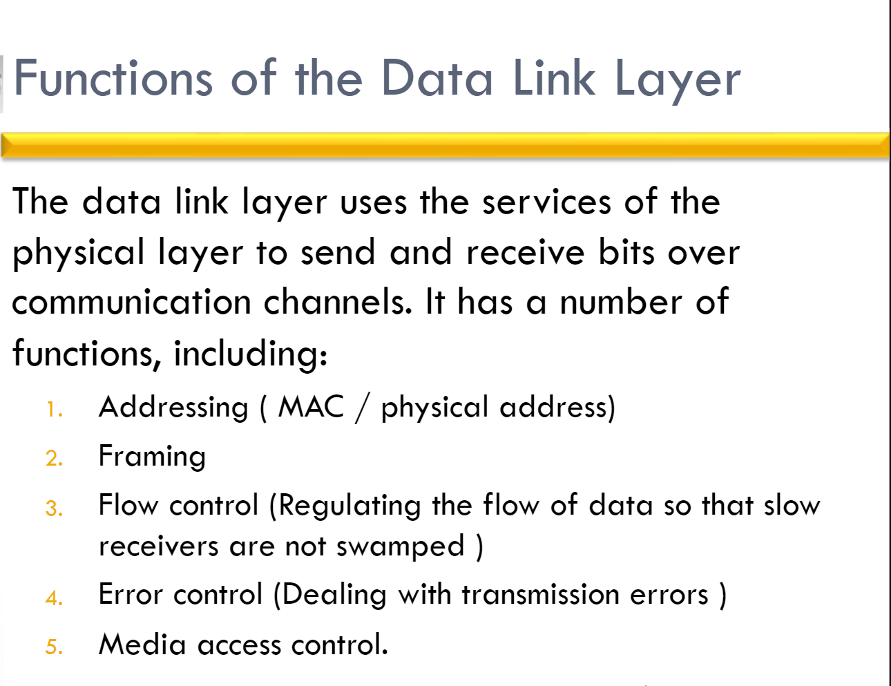

Slide 3
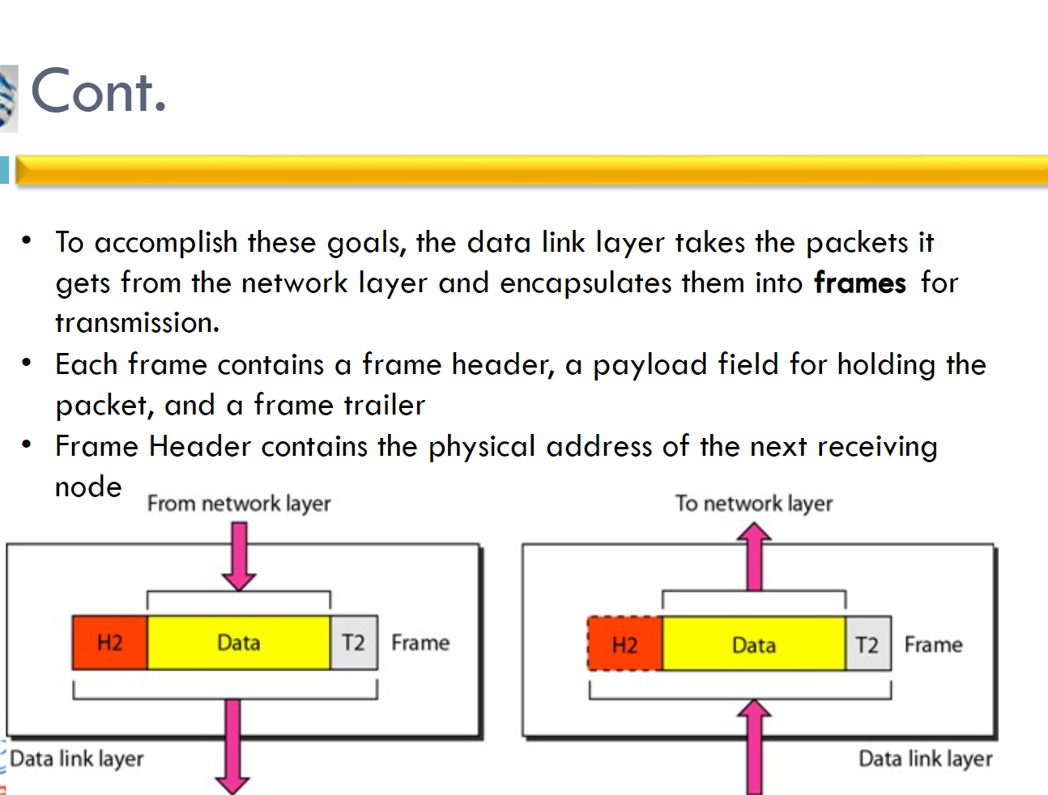

Slide 4

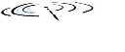














Link layer: introduction
terminology:
hosts, routers: nodes
communication channels that connect adjacent nodes along communication path: links
wired , wireless
LANs
layer-2 packet: frame, encapsulates datagram
mobile network
national or global ISP
datacenter
network
link layer has responsibility of
transferring datagram from one node
to physically adjacent node over a link
enterprise
network

Slide 5
Link layer: context
datagram transferred by different link protocols over different links:
e.g., WiFi on first link, Ethernet on next link
each link protocol provides different services
e.g., may or may not provide reliable data transfer over link

Slide 6







Transportation analogy
transportation analogy:
trip from Princeton to Lausanne
limo: Princeton to JFK
plane: JFK to Geneva
train: Geneva to Lausanne
tourist = datagram
transport segment = communication link
transportation mode = link-layer protocol
travel agent = routing algorithm
Princeton
JFK
Geneva
Lausanne

Slide 7


Link layer: services
framing, link access:
encapsulate datagram into frame, adding header, trailer
channel access if shared medium
“MAC” addresses in frame headers identify source, destination (different from IP address!)
reliable delivery between adjacent nodes
we already know how to do this!
seldom used on low bit-error links
wireless links: high error rates
Q: why both link-level and end-end reliability?
…
…
Cable access
cellular
Ethernet LANs
WiFi
Notes:
reliable delivery between adjacent nodes
Not always
Rdt likes we studied in transport layer
Reliable is not as important is correctness. How is correctness assured?
Wireless is subjected to noise, interference and has high bit error rate.
Why

Slide 8
Link layer: services (more)
…
flow control:
pacing between adjacent sending and receiving nodes
error detection:
errors caused by signal attenuation, noise.
receiver detects errors, signals retransmission, or drops frame
error correction:
receiver identifies and corrects bit error(s) without retransmission
half-duplex and full-duplex:
with half duplex, nodes at both ends of link can transmit, but not at same time
…
Cable access
cellular
Ethernet LANs
WiFi
Notes:
Error detection in the link layer is usually more sophisticated and is implemented in hardware. Error correction is similar to error detection, except that a receiver not only detects when bit errors have occurred in the frame but also deter- mines exactly where in the frame the errors have occurred (and then corrects these errors).

Slide 9

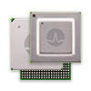

Host link-layer implementation
in each-and-every host
link layer implemented on-chip or in network interface card (NIC)
implements link, physical layer
attaches into host’s system buses
combination of hardware, software, firmware
application
transport
network
link
cpu
memory
host bus
(e.g., PCI)
controller
link
physical
physical
network interface
Notes:
The Ethernet capabilities are either integrated into the motherboard chipset or implemented via a low-cost dedicated Ethernet chip. For the most part, the link layer is implemented on a chip called the network adapter, also sometimes known as a network interface controller (NIC). The network adapter implements many link layer services including framing, link access, error detection, and so on. Thus, much of a link-layer controller’s functionality is implemented in hardware. For example, Intel’s 700 series adapters [Intel 2020] implements the Ethernet protocols we’ll study in Section 6.5; the Atheros AR5006 [Atheros 2020] controller implements the 802.11 WiFi protocols we’ll study in Chapter 7.
Figure 6.2 shows that while most of the link layer is implemented in hardware, part of the link layer is implemented in software that runs on the host’s CPU. The software components of the link layer implement higher-level link-layer functionality such as assembling link-layer addressing information and activating the controller hardware. On the receiving side, link-layer software responds to con- troller interrupts (for example, due to the receipt of one or more frames), handling error conditions and passing a datagram up to the network layer. Thus, the link layer is a combination of hardware and software

Slide 10
Interfaces communicating
application
transport
network
link
application
transport
network
link
cpu
memory
memory
CPU
datagram
link_{h}
datagram
controller
controller
datagram
link_{h}
link
physical
link
physical
physical
physical
sending side:
encapsulates datagram in frame
adds error checking bits, reliable data transfer, flow control, etc.
receiving side:
looks for errors, reliable data transfer, flow control, etc.
extracts datagram, passes to upper layer at receiving side

Slide 11
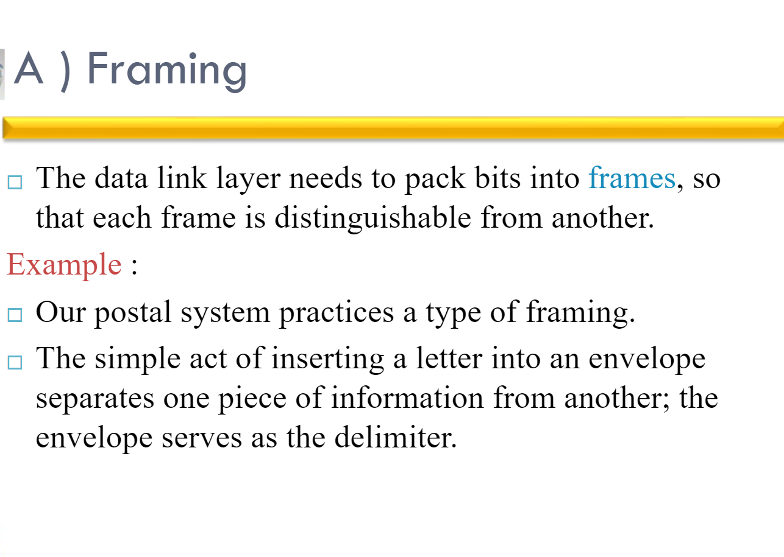

Slide 12
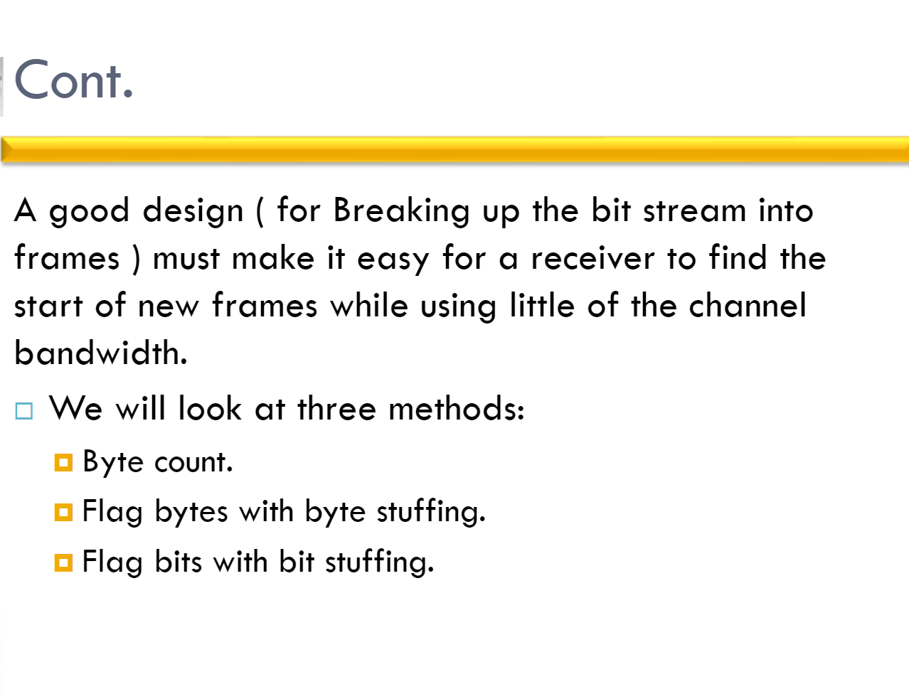

Slide 13
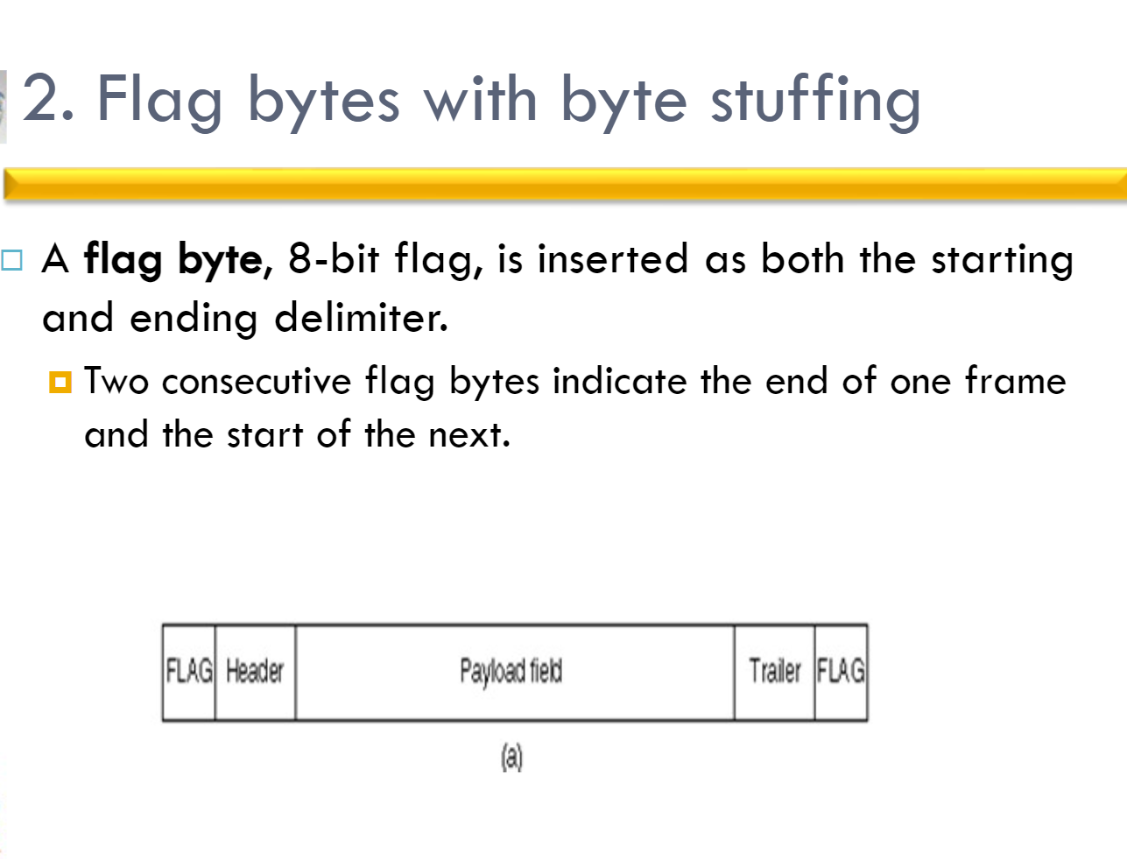

Slide 14
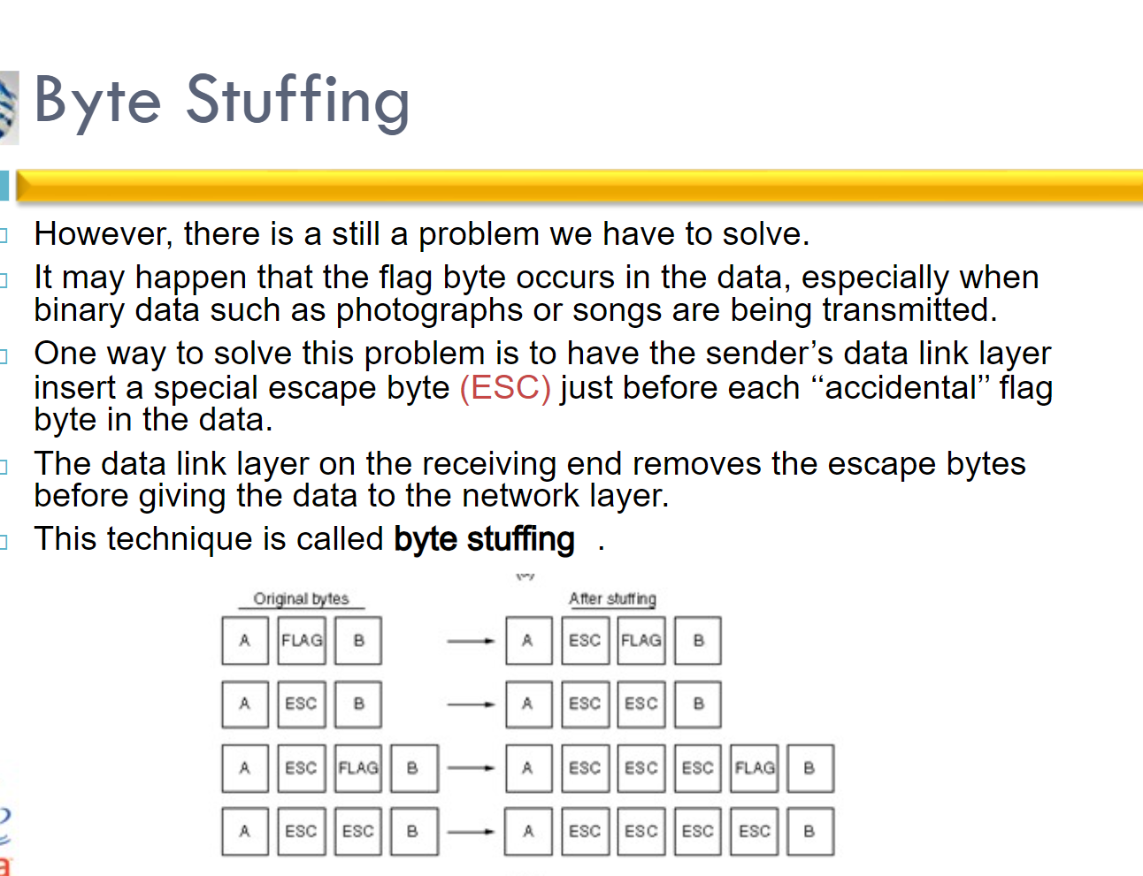

Slide 15
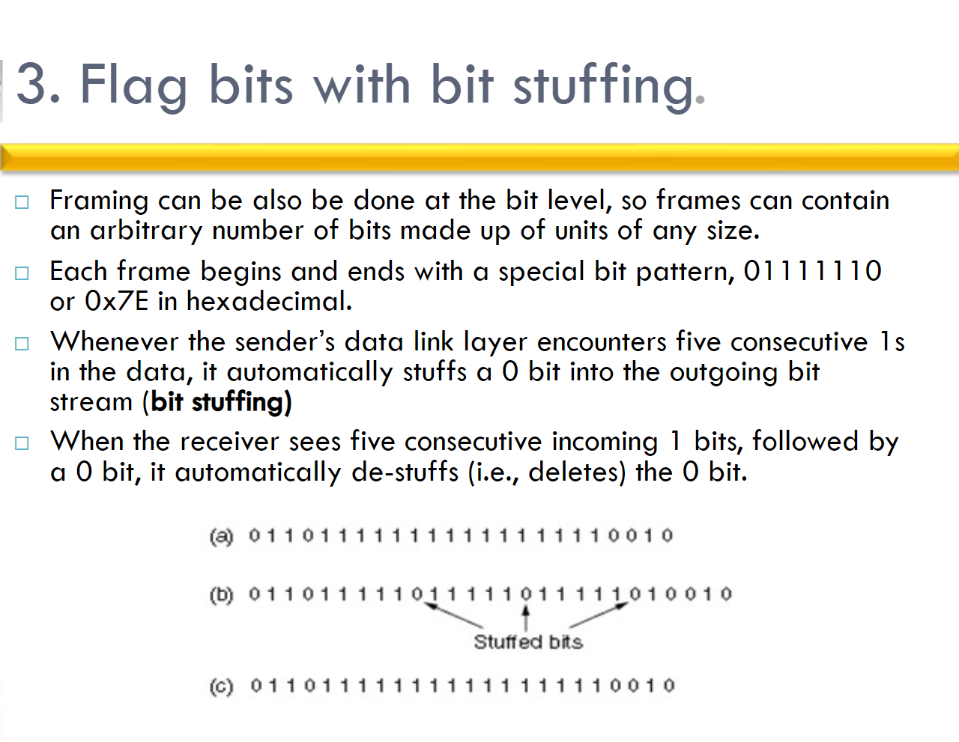

Slide 16
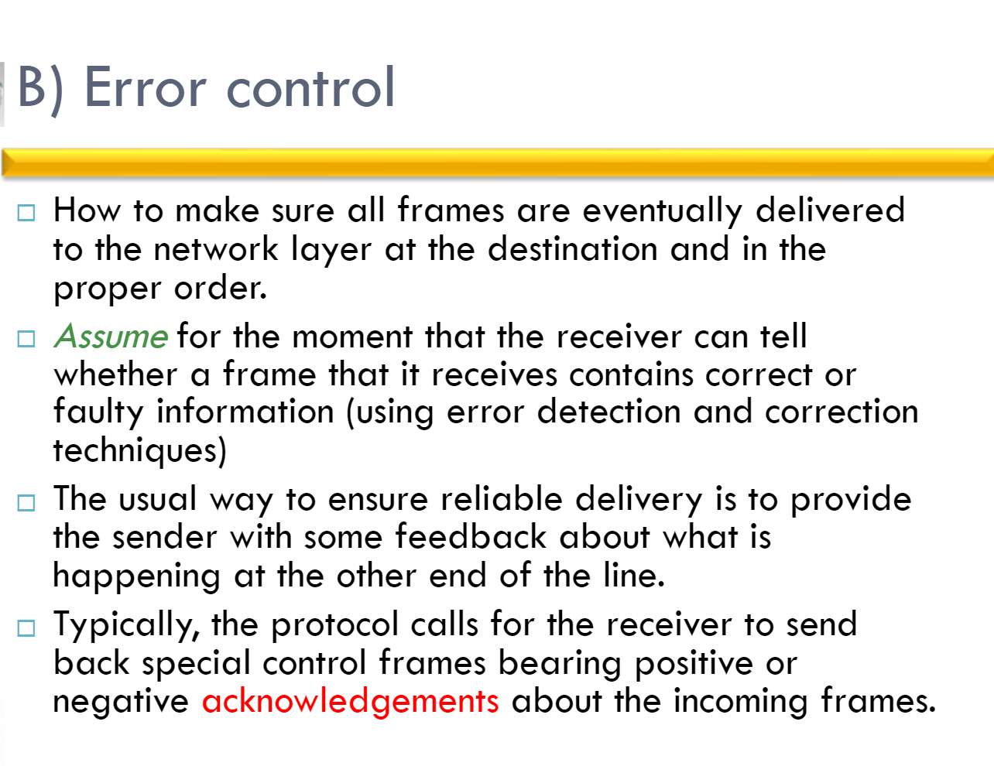

Slide 17
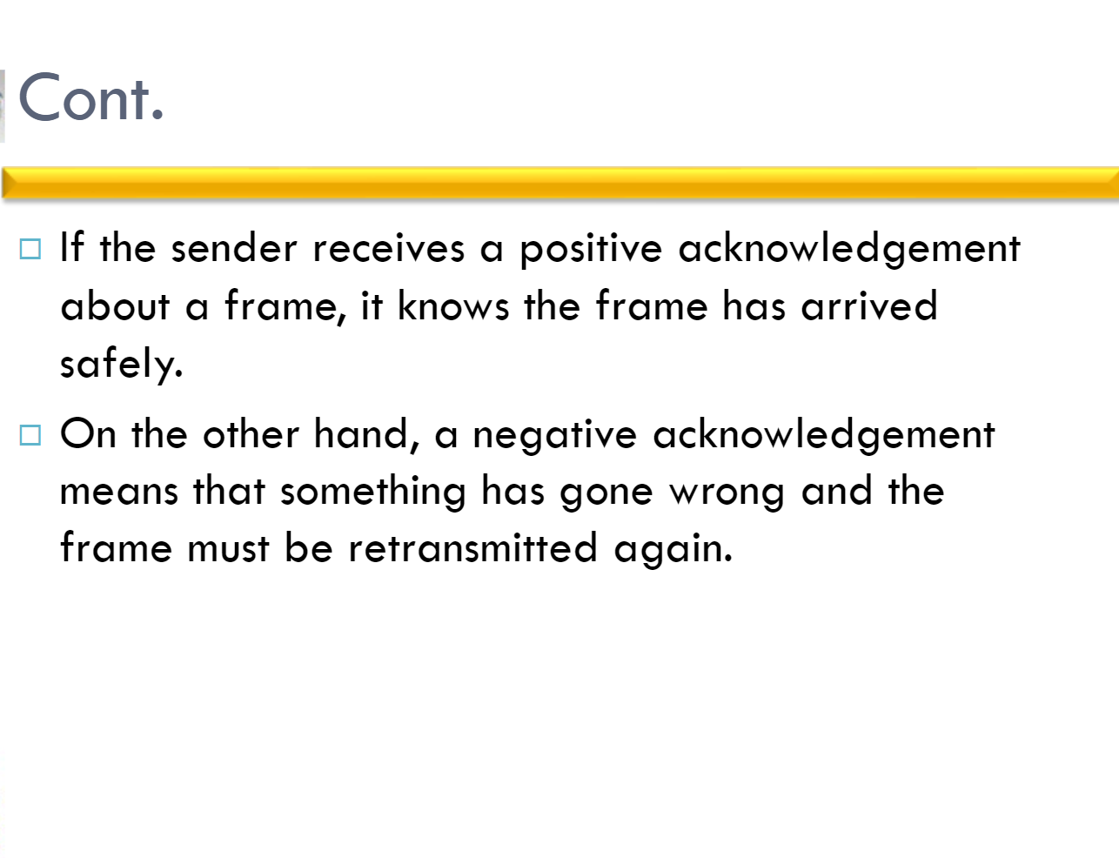

Slide 18
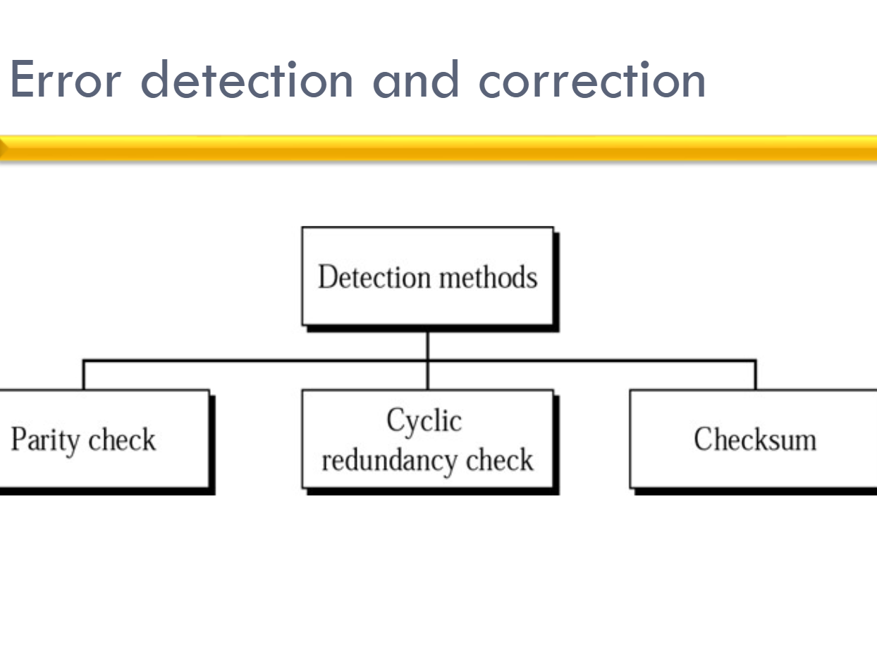

Slide 19
Error detection
EDC: error detection and correction bits (e.g., redundancy)
D: data protected by error checking, may include header fields
datagram
datagram
Error detection not 100% reliable!
protocol may miss some errors, but rarely
larger EDC field yields better detection and correction
otherwise
all
bits in D’
OK
?
N
detected
error
d data bits
D
EDC
D’
EDC’
bit-error prone link

Slide 20

Parity checking
Can detect and correct errors (without retransmission!)
two-dimensional parity: detect and correct single bit errors
single bit parity:
detect single bit errors
0111000110101011
1
row parity
d data bits
d_{1,1}
. . .
d_{1,j}
d_{1,j+1}
d_{2,1}
. . .
d_{2,j}
d_{2,j+1}
parity bit
. . .
. . .
. . .
. . .
Even/odd parity: set parity bit so there is an even/odd number of 1’s
d_{i,1}
. . .
d_{i,j}
d_{i,j+1}
column
parity
d_{i+1,1}
. . .
d_{i+1,j}
d_{i+1,j+1}
At receiver:
compute parity of d received bits
compare with received parity bit – if different than error detected
no errors:
1 0 1 0 1
1
detected
and
correctable
single-bit
error:
1 0 1 0 1 1
1 1 1 1 0
0
1 0 1 1 0 0
parity
error
0 1 1 1 0
1
0 1 1 1 0 1
1 0 1 0 1
0
1 0 1 0 1 0
parity
error
* Check out the online interactive exercises for more examples: http://gaia.cs.umass.edu/kurose_ross/interactive/
Notes:
Two Parity type (Odd or Even)
Odd Parity:
Total No. of 1's in the code, including the parity bit should be odd
For example, there are 7 data bits and 1 parity bit
1 0 1 1 0 0 1 x
here 1 occur 4 times (should add 1 ) so parity bit should be equal to 1,
1 0 1 1 0 1 1 x
here 1 occur 5 times (should add 0 ) so parity bit should be equal to 0,
Even Parity:
Total No. of 1's in the code, including the parity bit should be even
For example, there are 7 data bits and 1 parity bit
1 1 0 1 0 1 1 x
here 1 occur 5 times (should add 1 ) so parity bit should be equal to 1,
1 1 1 0 0 0 1 x
here 1 occur 4 times (should add 0 ) so parity bit should be equal to 0,

Slide 21
Internet checksum (review, see section 3.3)
Goal: detect errors (i.e., flipped bits) in transmitted segment
sender:
treat contents of UDP segment (including UDP header fields and IP addresses) as sequence of 16-bit integers
checksum: addition (one’s complement sum) of segment content
checksum value put into UDP checksum field
receiver:
compute checksum of received segment
check if computed checksum equals checksum field value:
not equal - error detected
equal - no error detected. But maybe errors nonetheless? More later ….

Slide 22
Cyclic Redundancy Check (CRC)
more powerful error-detection coding
D: data bits (given, think of these as a binary number)
G: bit pattern (generator), of r+1 bits (given, specified in CRC standard)
r CRC bits
d data bits
D
R
bits to send
<D,R> = D 2^{r} XOR R
formula for these bits
*
sender: compute r CRC bits, R, such that <D,R> exactly divisible by G (mod 2)
receiver knows G, divides <D,R> by G. If non-zero remainder: error detected!
can detect all burst errors less than r+1 bits
widely used in practice (Ethernet, 802.11 WiFi)

Slide 23
Cyclic Redundancy Check (CRC): example
G
Sender wants to compute R such that:
D . 2^{r} XOR R = nG
1
0
1
0 1 1
1 0 0 1
1 0 1 1 1 0
0 0 0
1 0 0 1
1 0 1
D
2^{r} (here, r=3)
0 0 0
*
... or equivalently (XOR R both sides):
D . 2^{r} = nG XOR R
1 0 1 0
1 0 0 1
1 1 0
... which says:
if we divide D . 2^{r} by G, we want remainder R to satisfy:
0 0 0
1 1 0 0
1 0 0 1
1 0 1 0
1 0 0 1
D.2^{r}
G
algorithm for
computing R
R = remainder [ ]
0 1 1
R
* Check out the online interactive exercises for more examples: http://gaia.cs.umass.edu/kurose_ross/interactive/

Slide 24
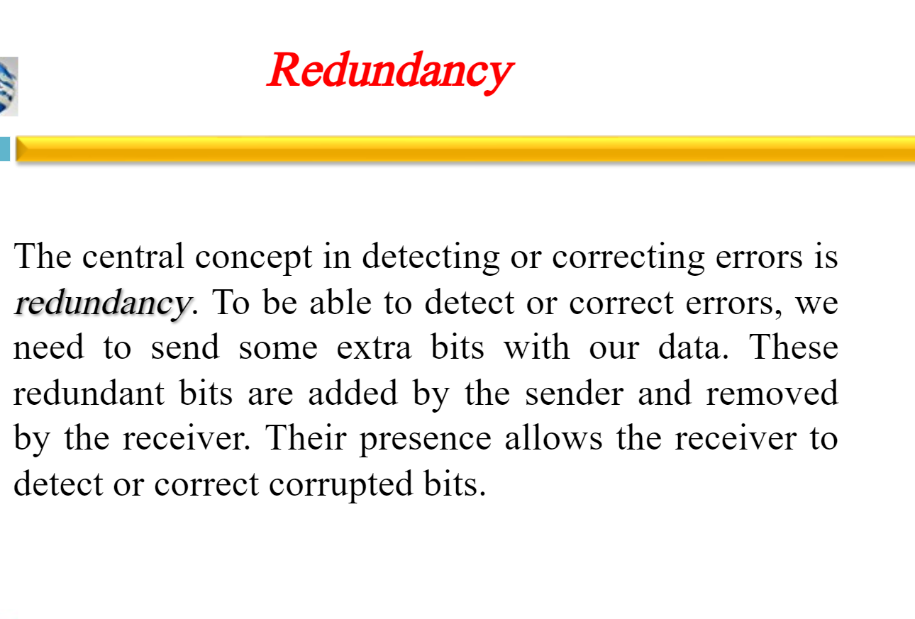

Slide 25
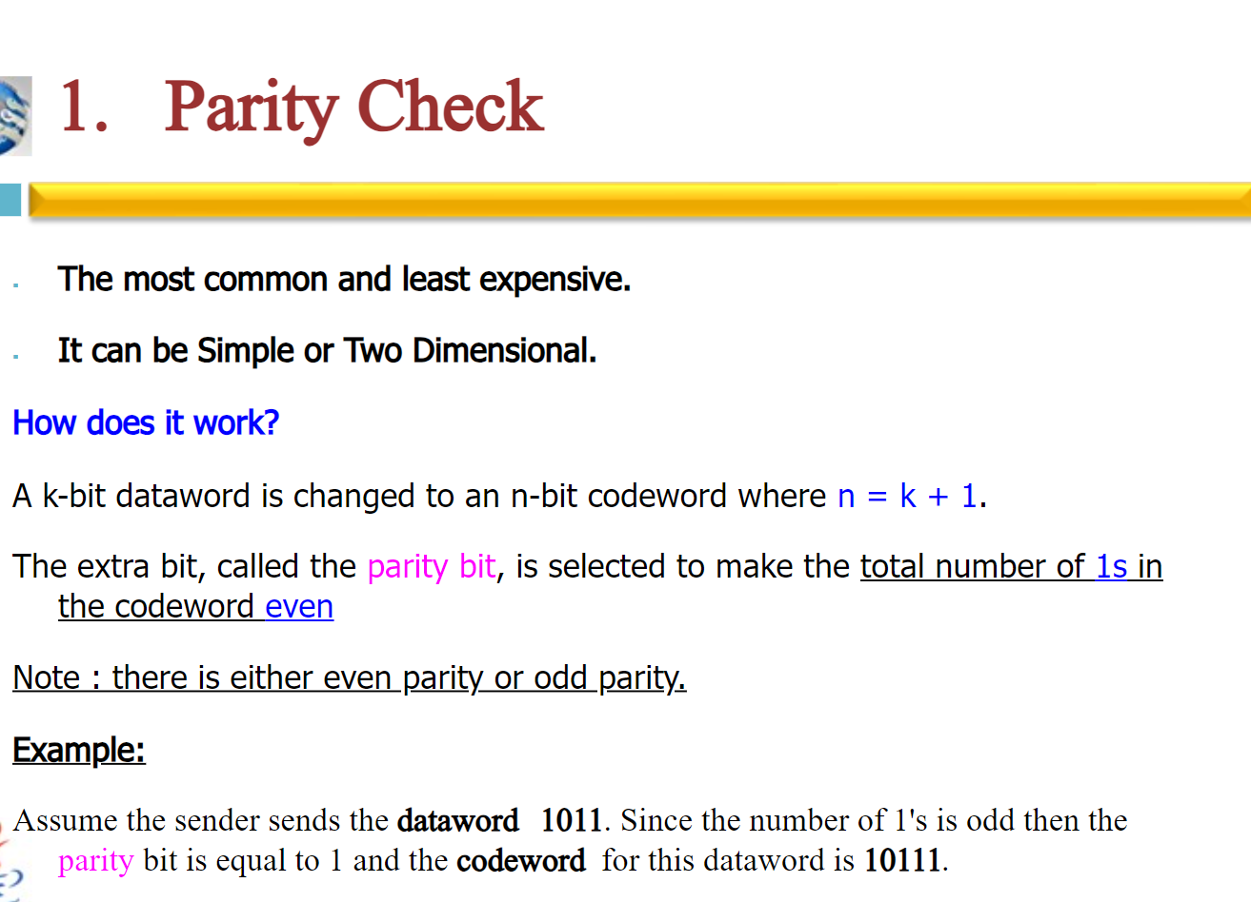

Slide 26
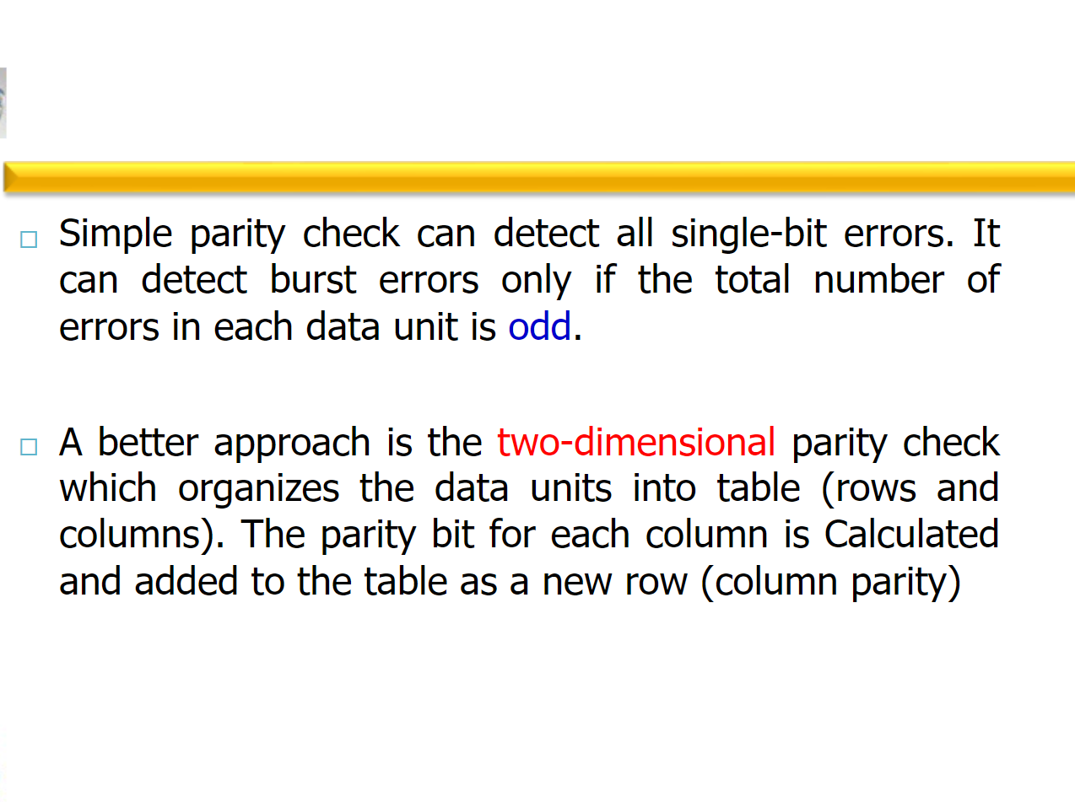

Slide 27
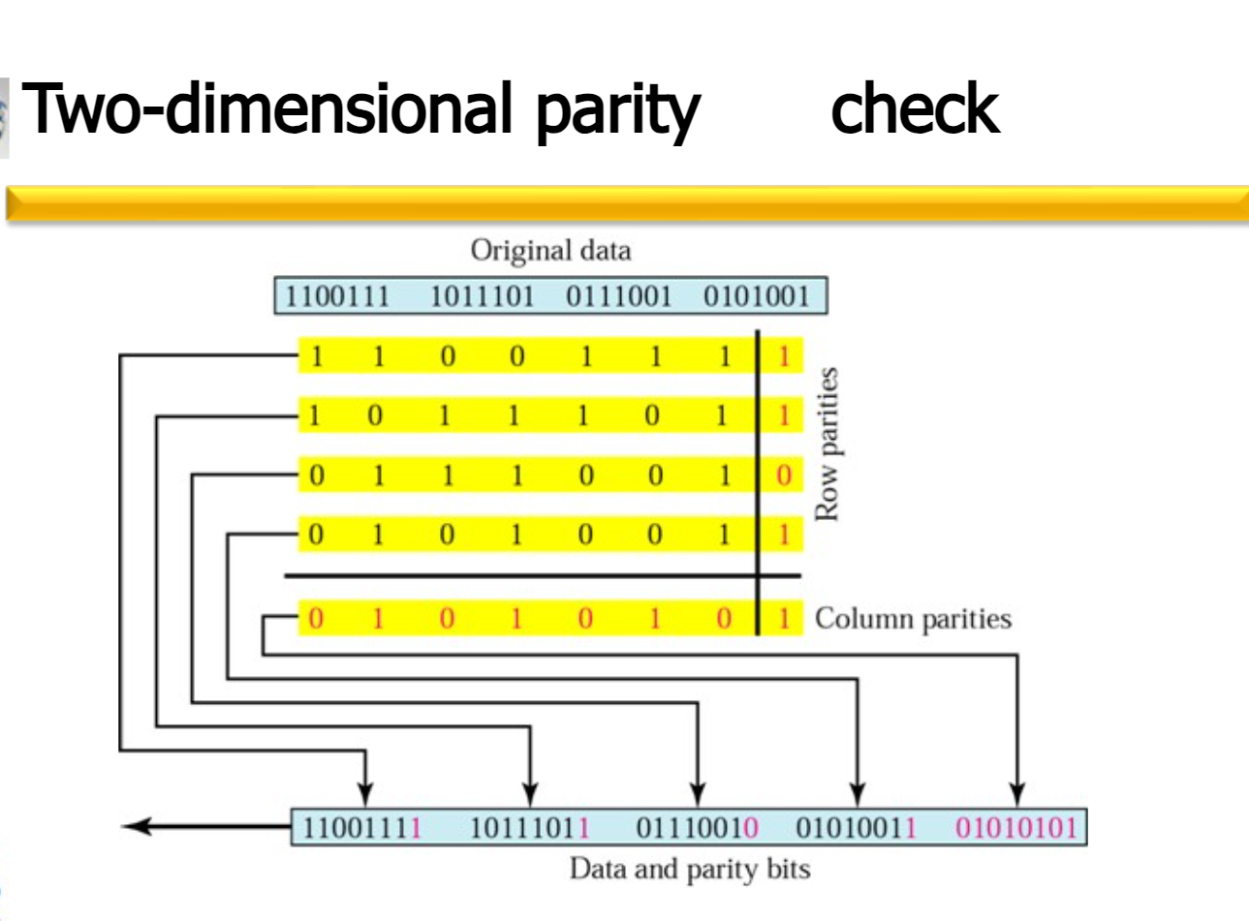

Slide 28
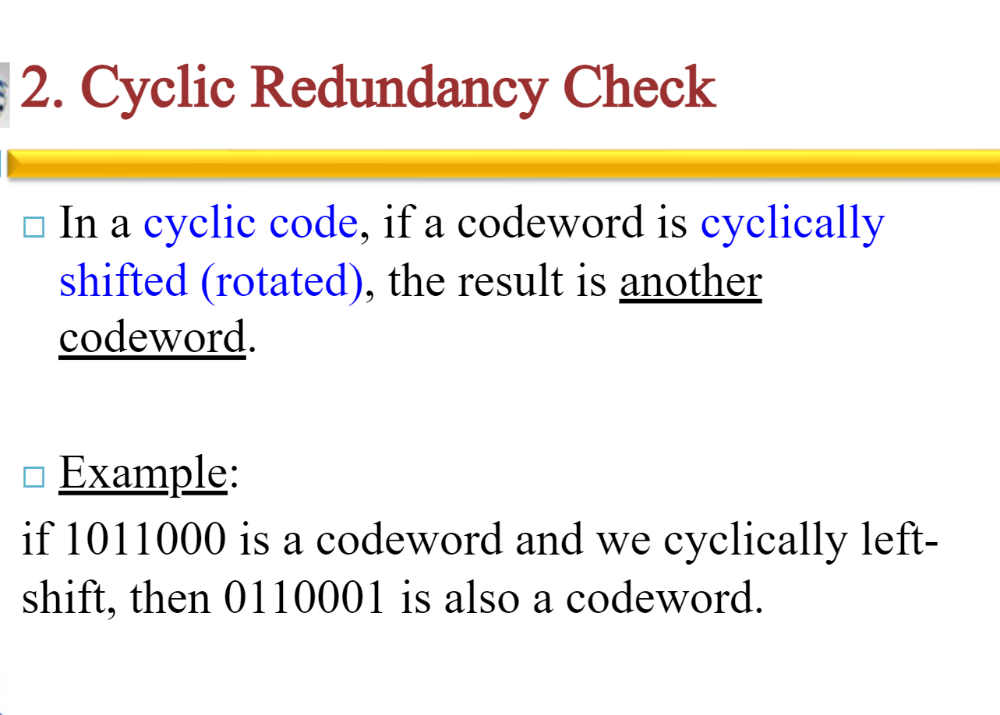

Slide 29
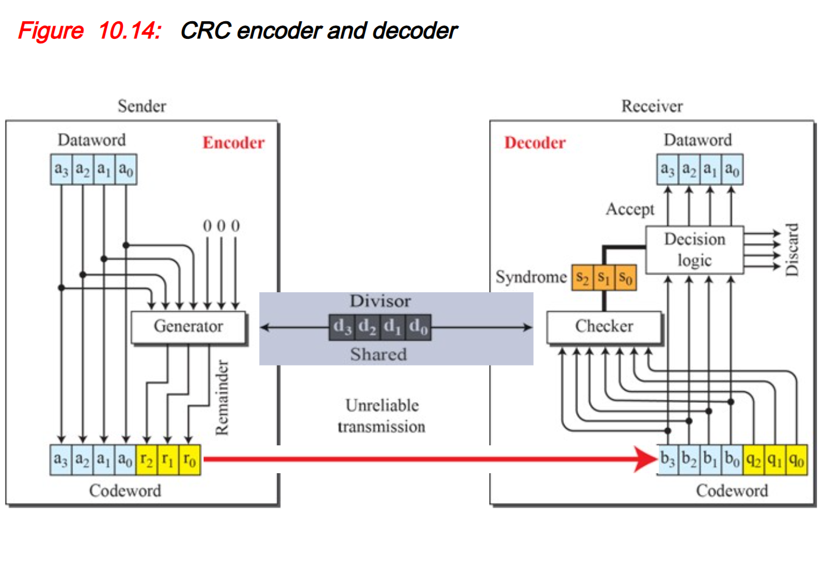

Slide 30
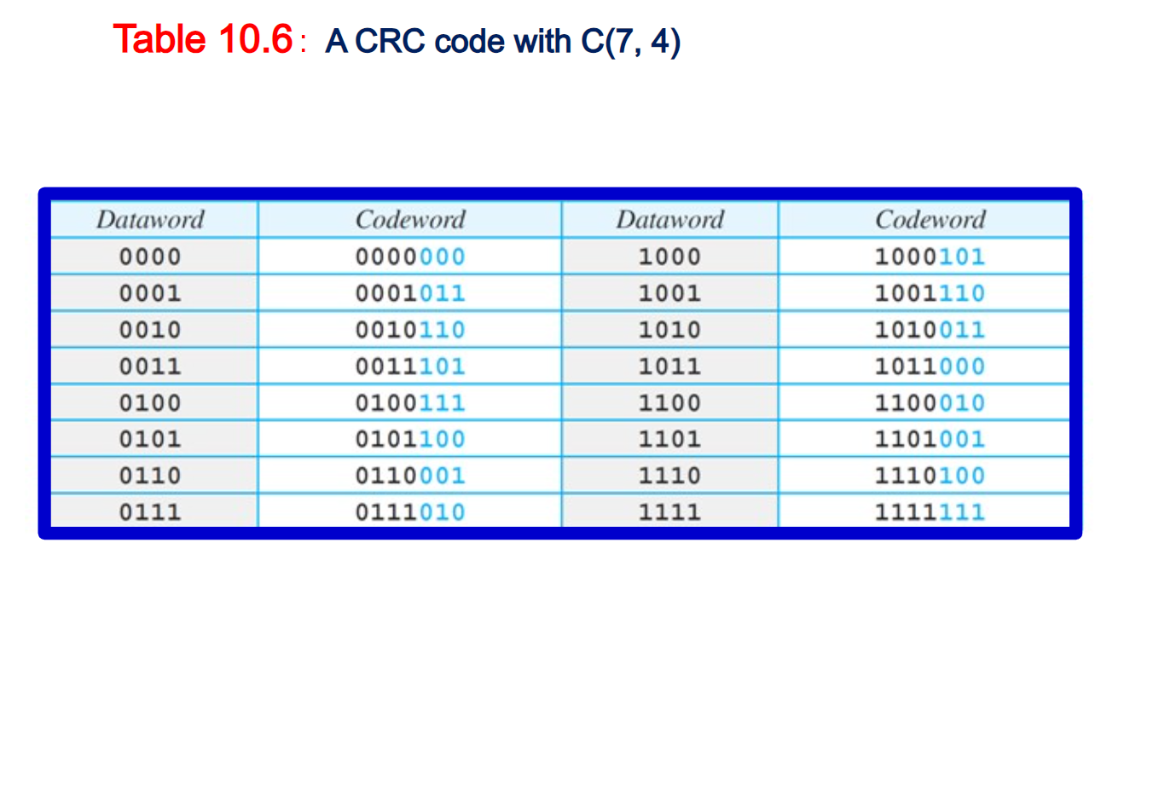

Slide 31
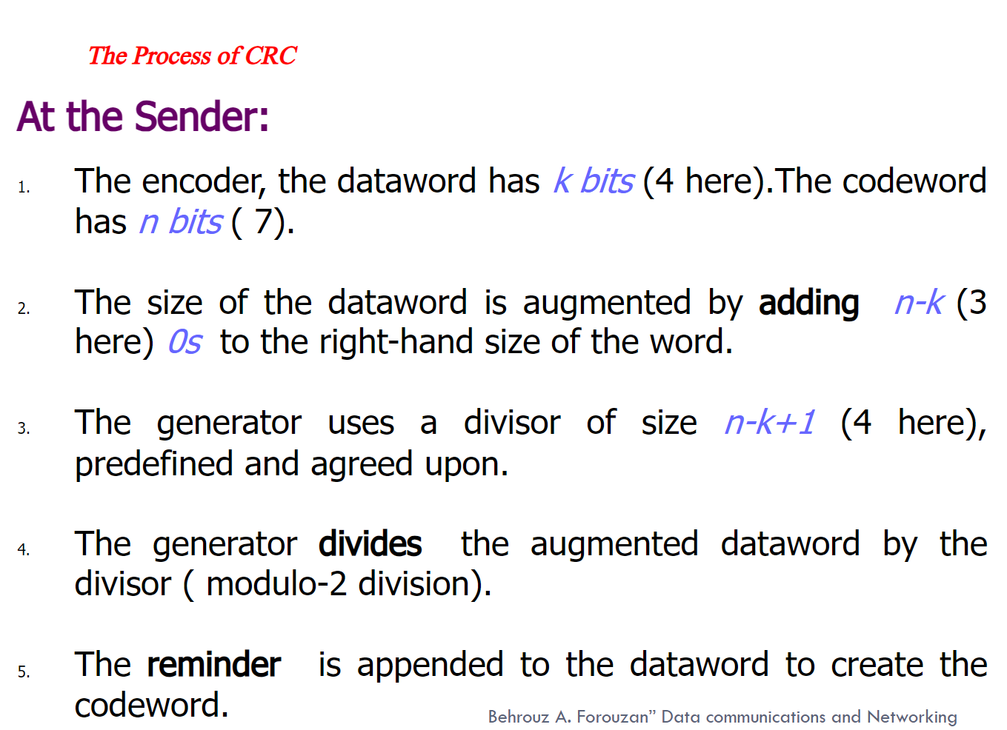

Slide 32
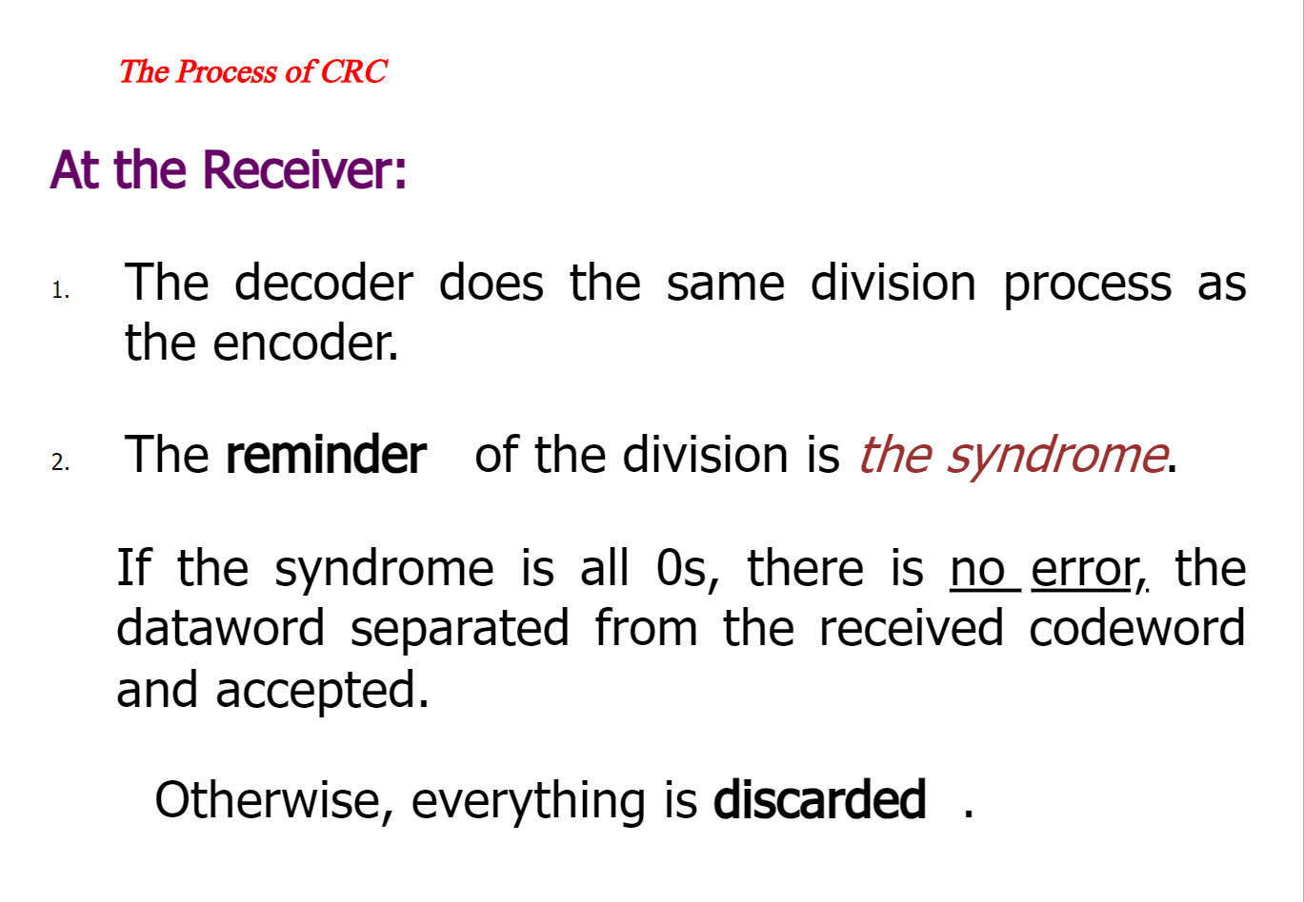

Slide 33
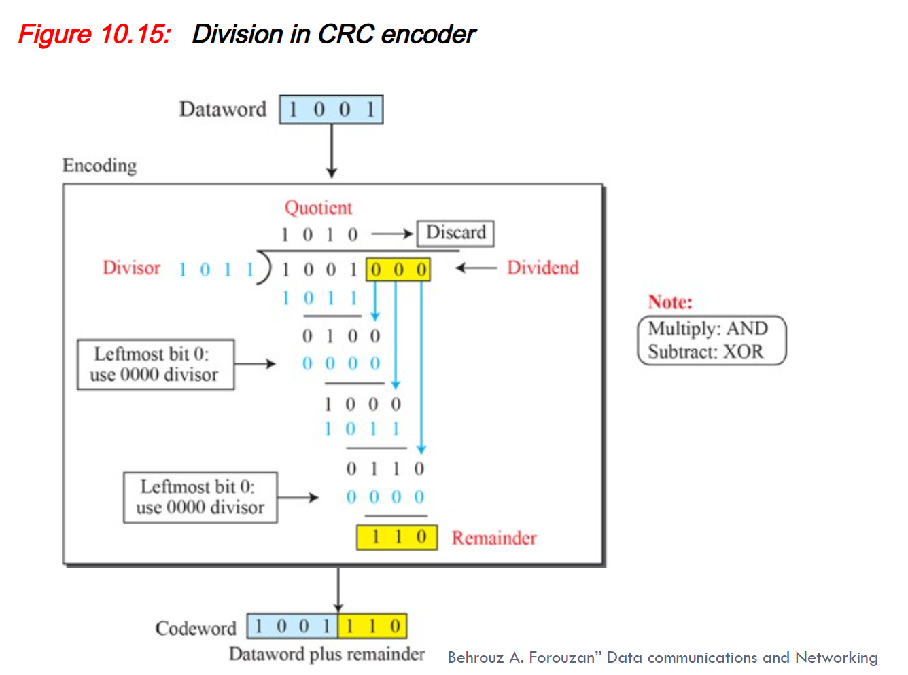

Slide 34
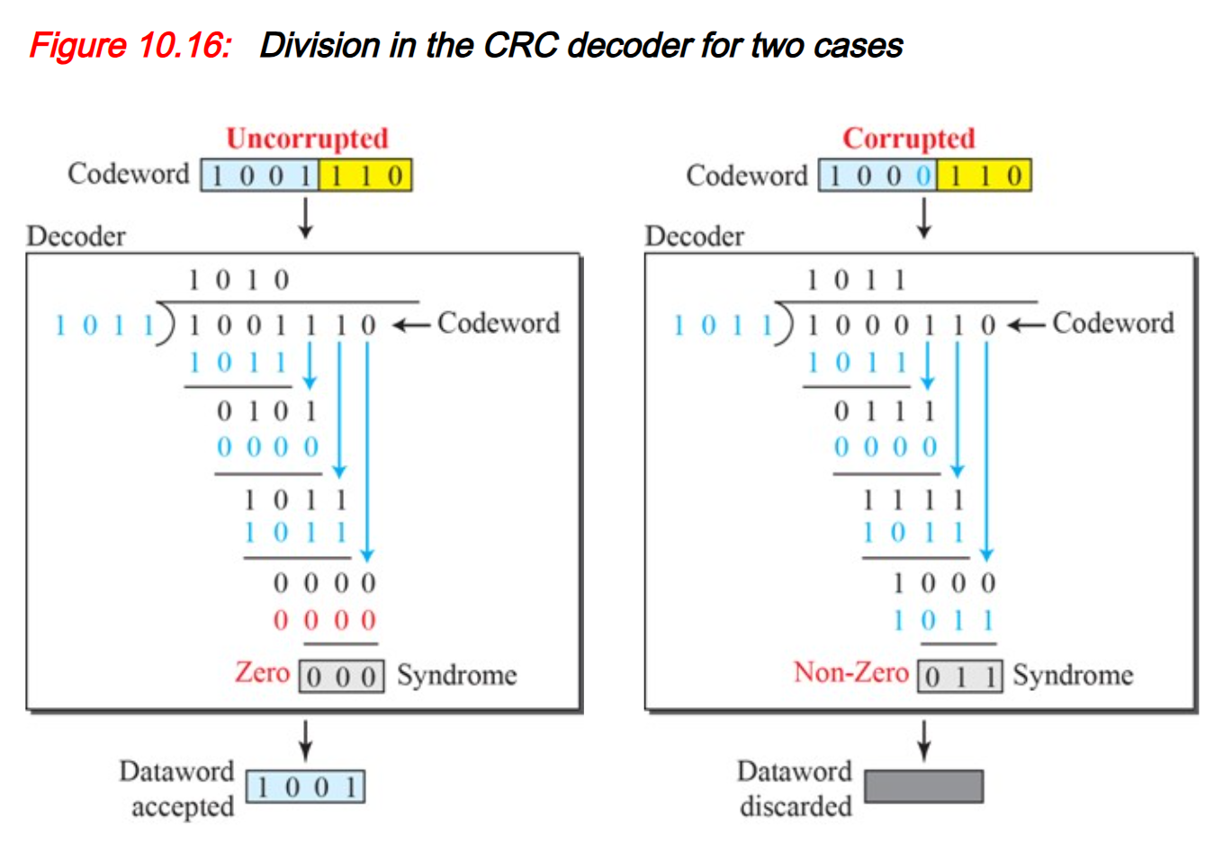

Slide 35
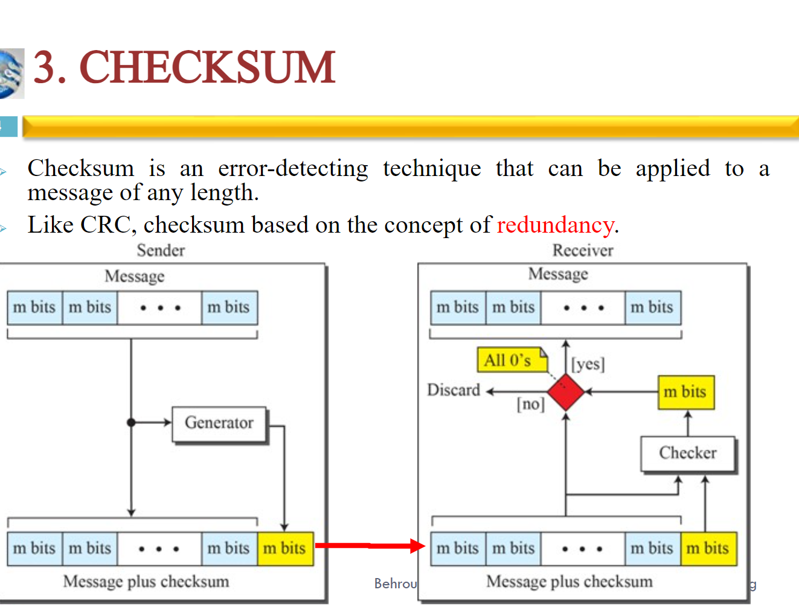

Slide 36
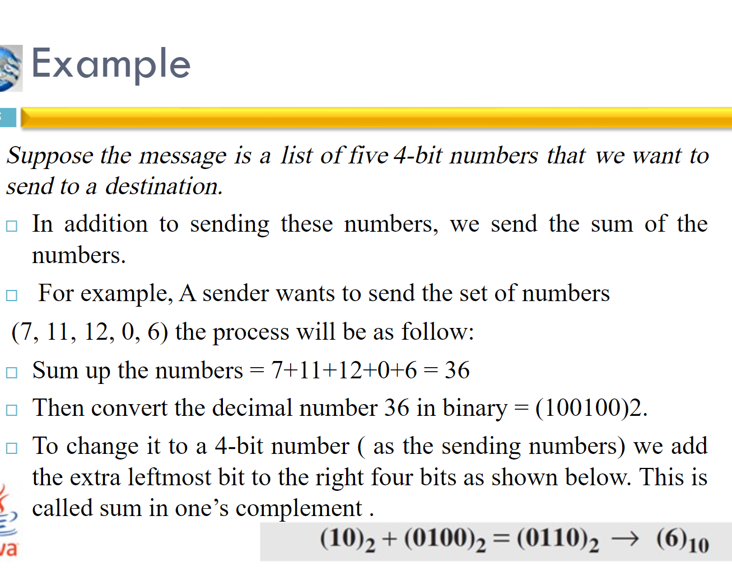

Slide 37
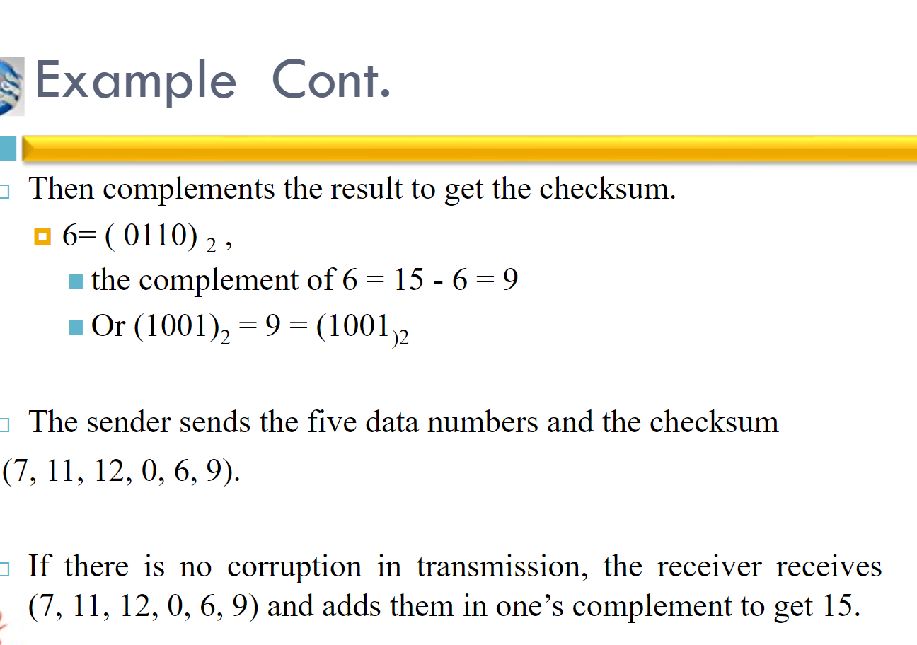

Slide 38
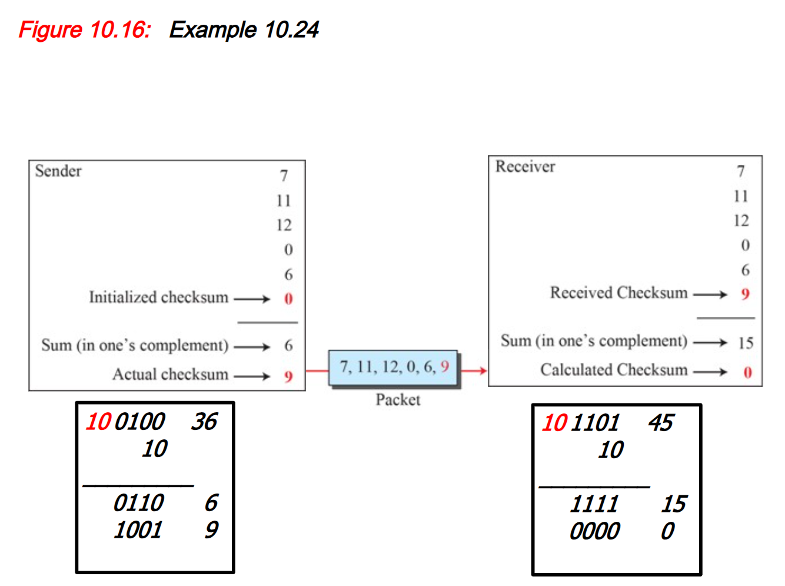

Slide 39
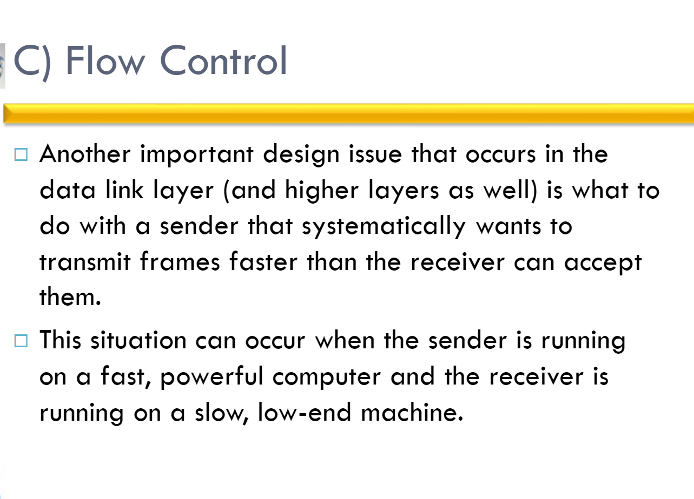

Slide 40
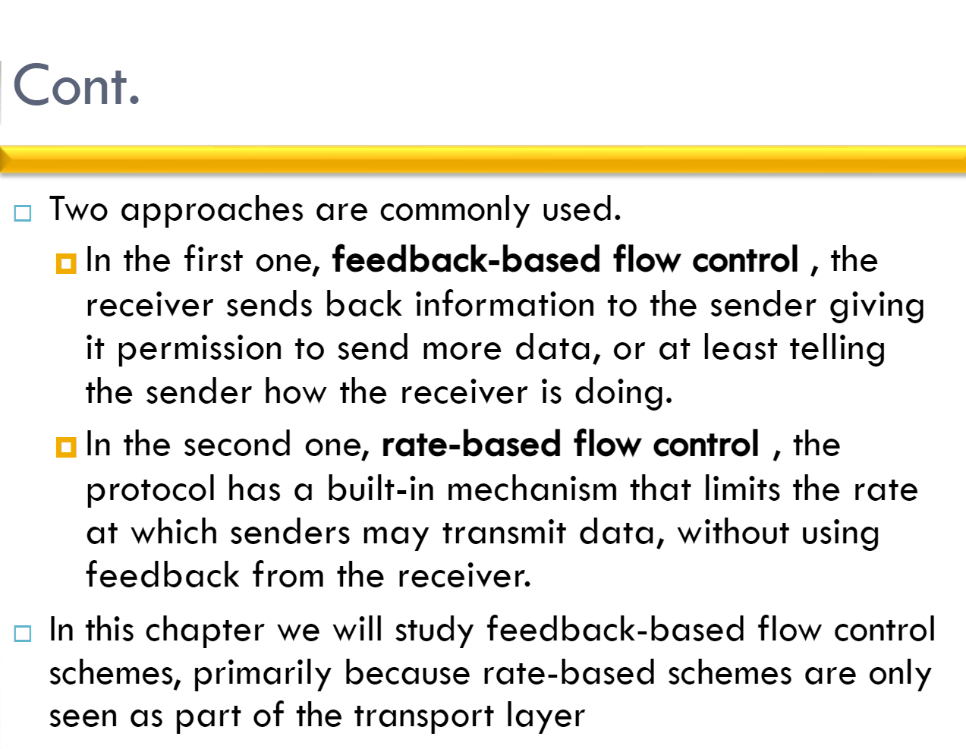

Slide 41
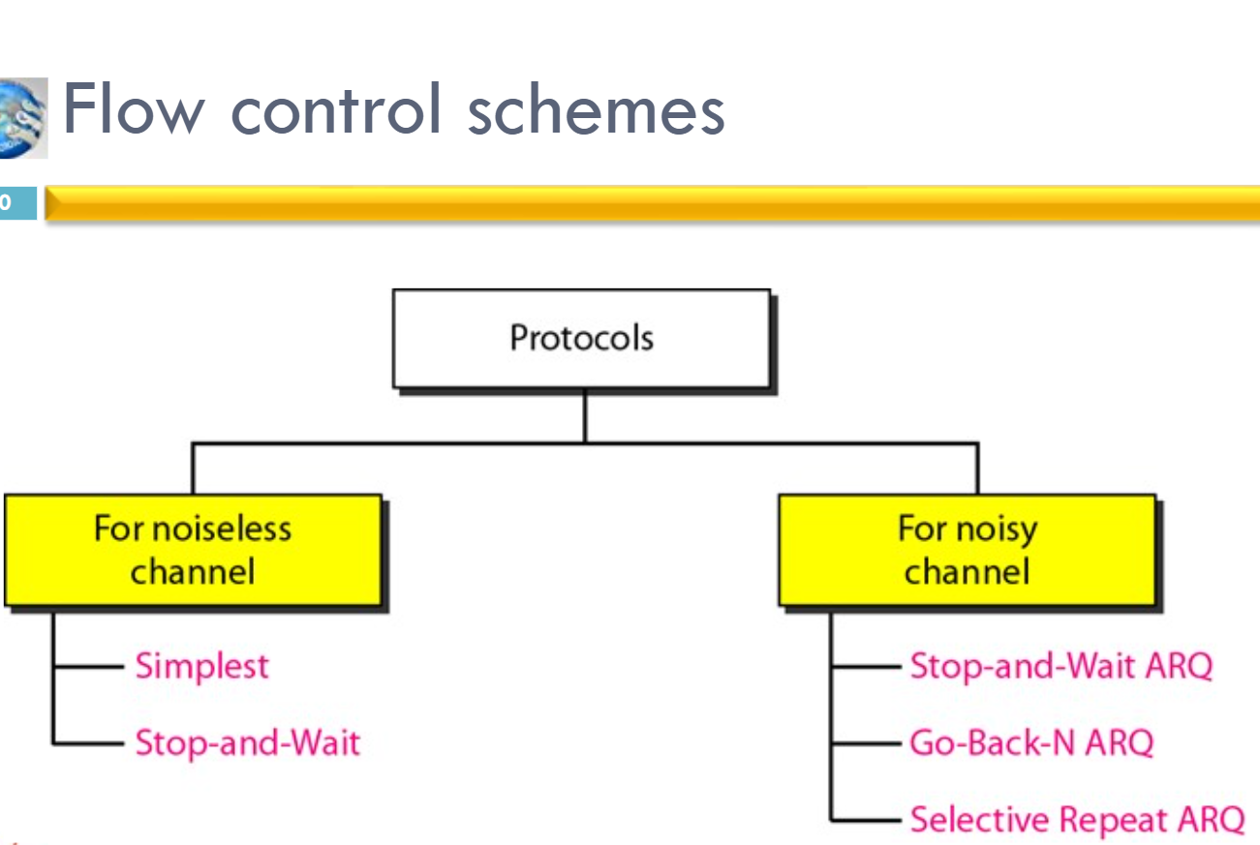

Slide 42
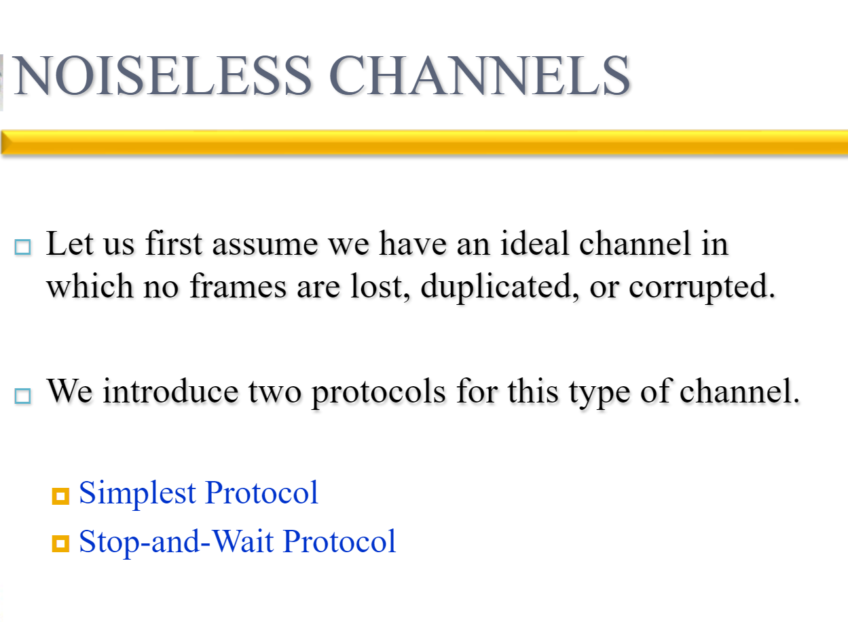

Slide 43
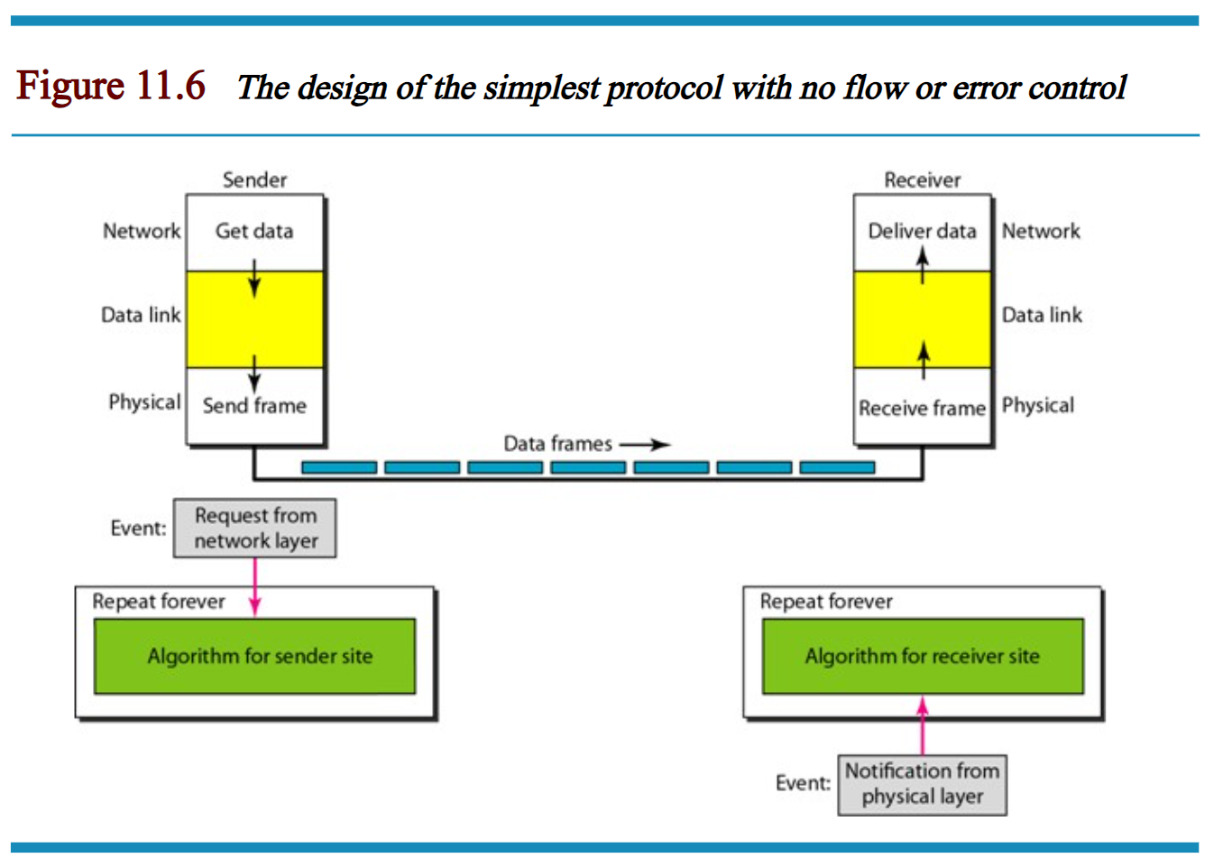

Slide 44
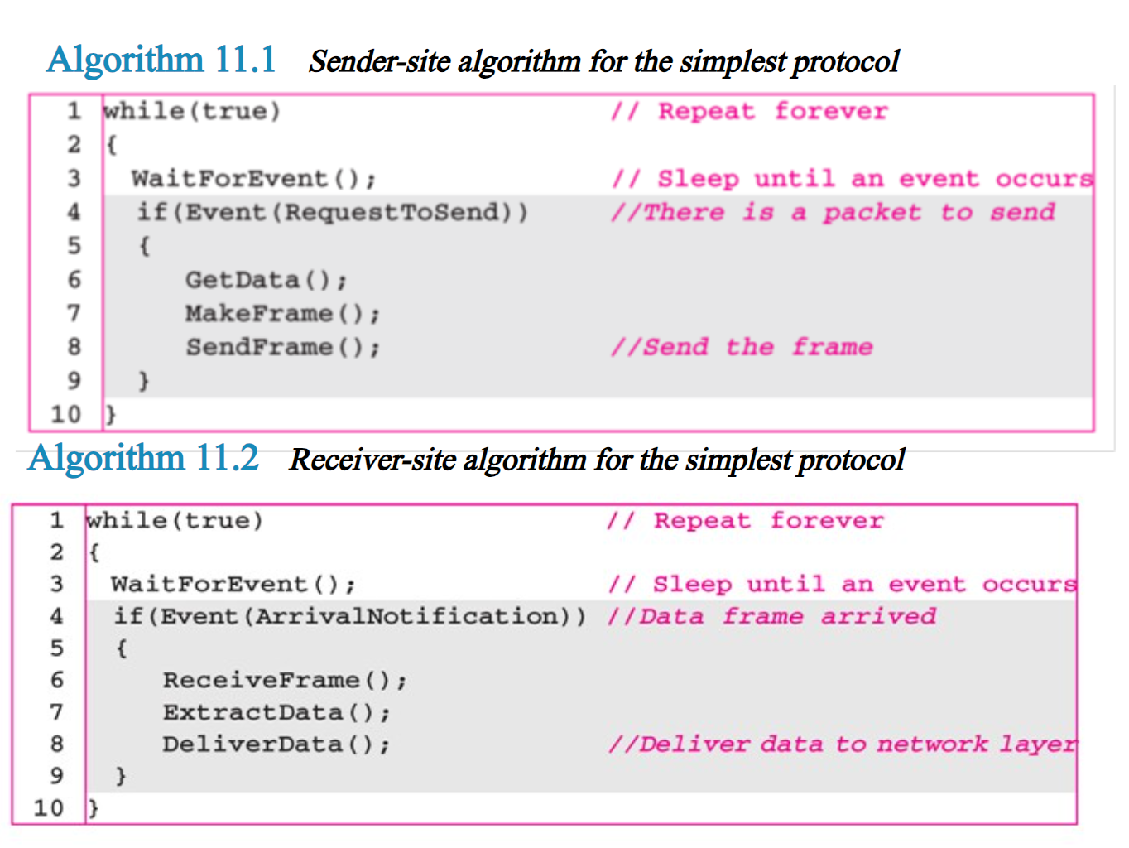

Slide 45
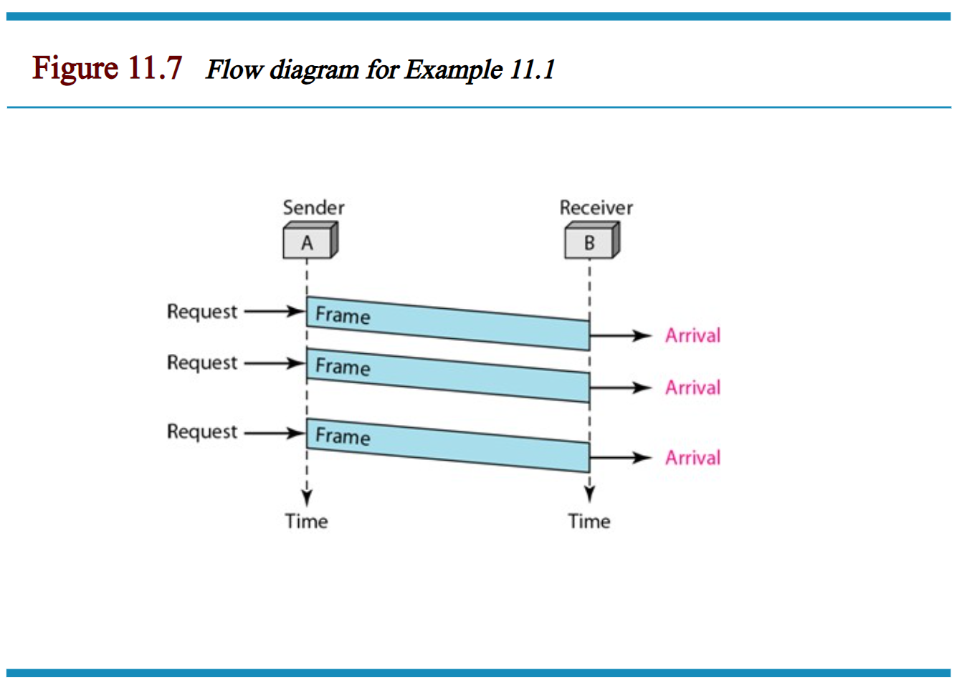

Slide 46
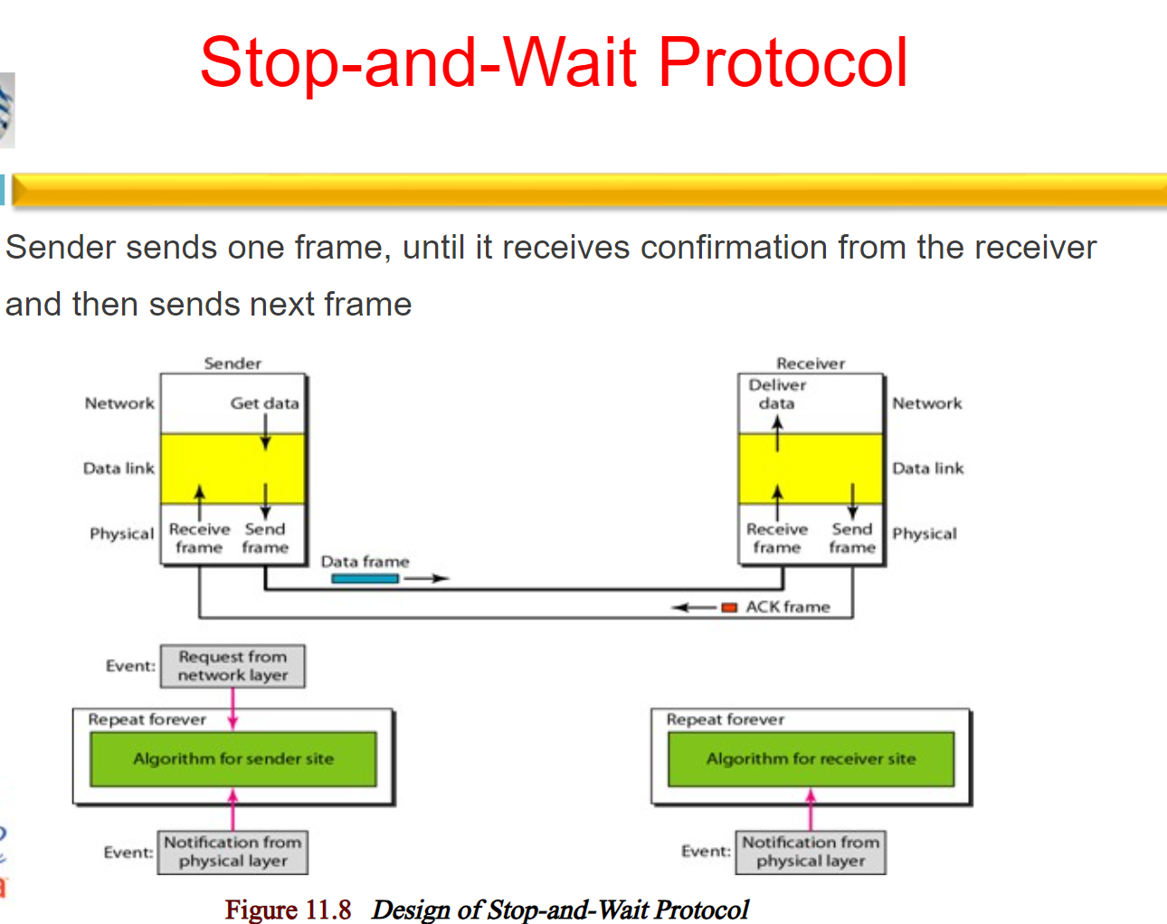

Slide 47
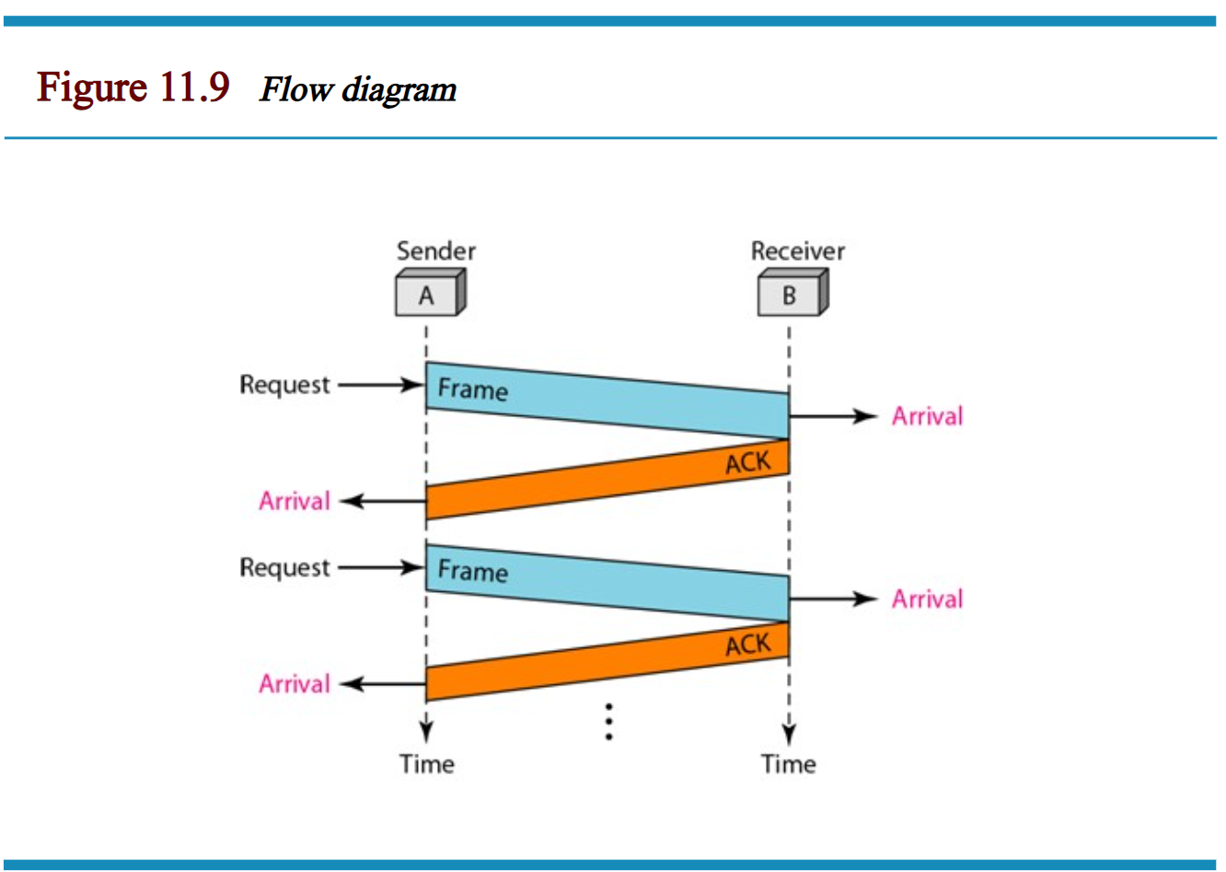

Slide 48
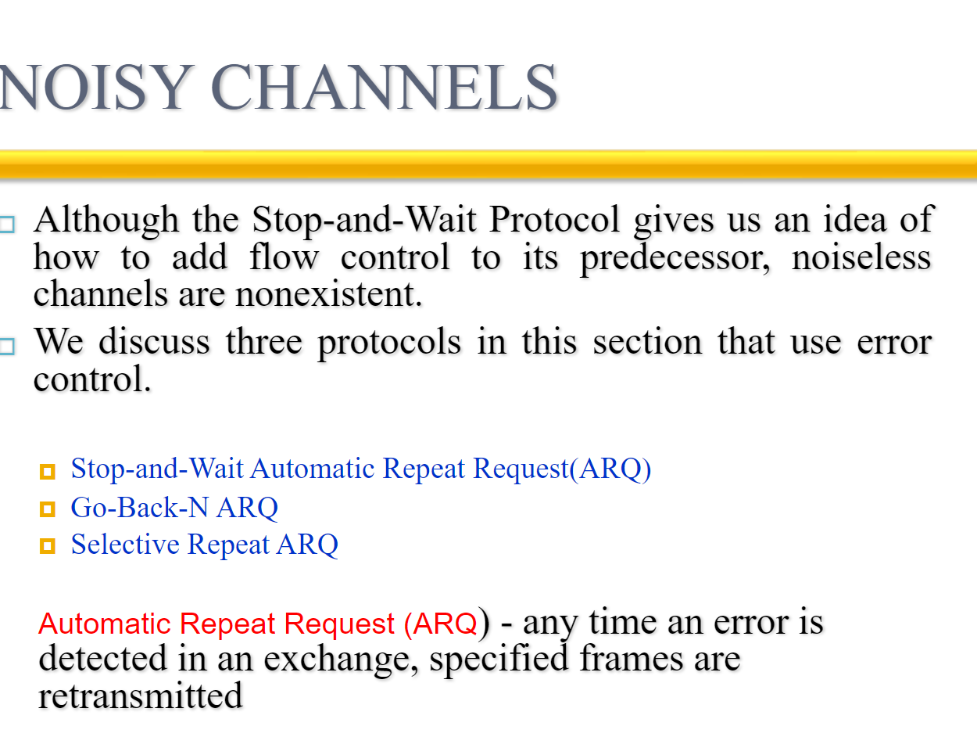

Slide 49
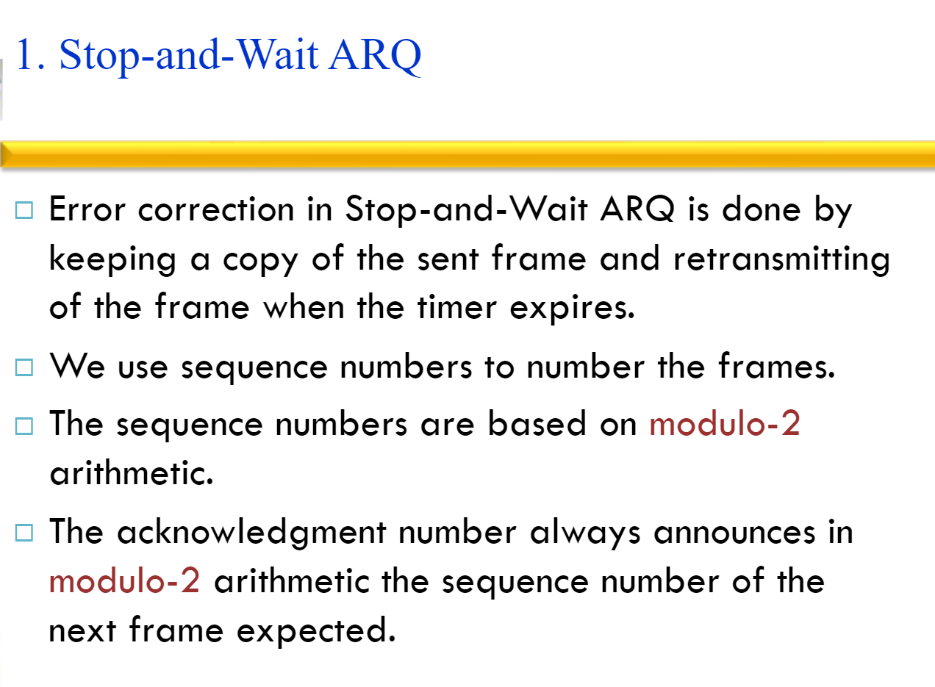

Slide 50
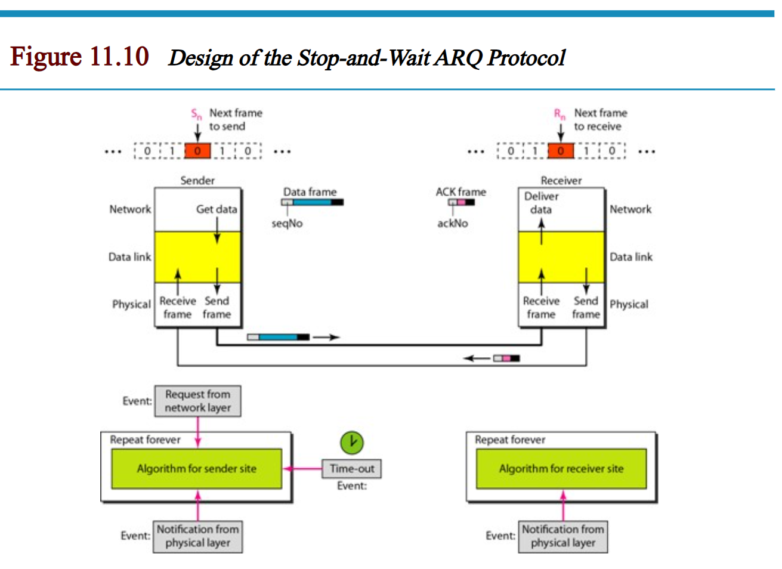

Slide 51
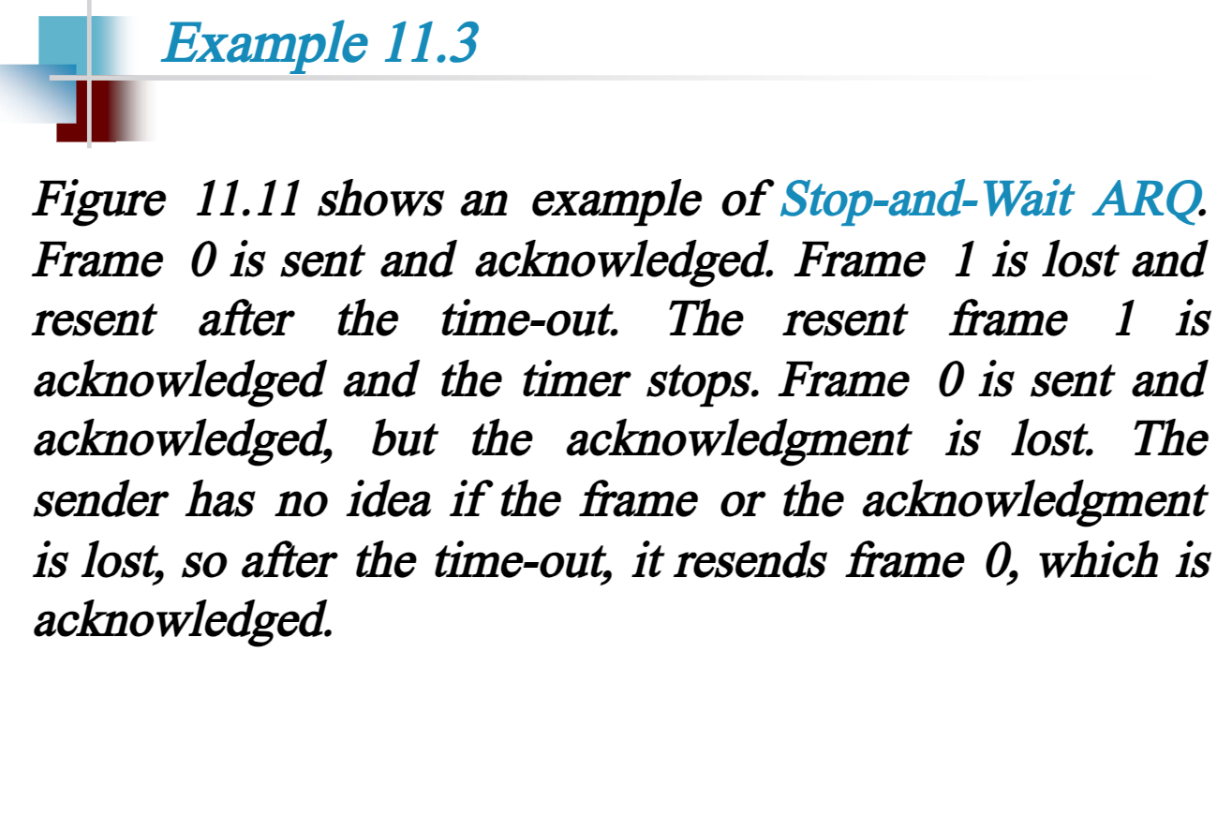

Slide 52
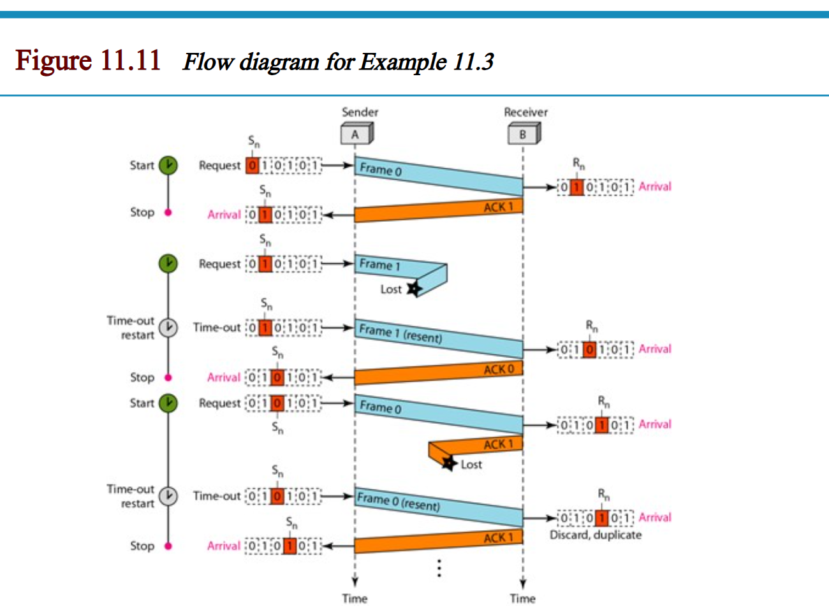

Slide 53
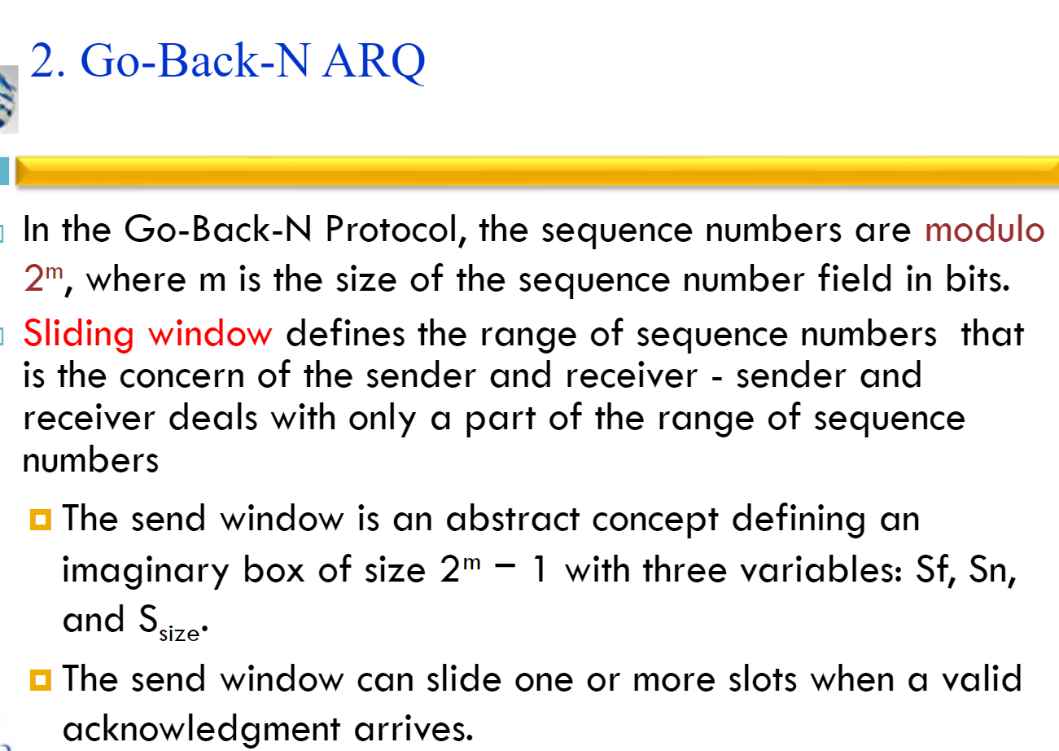

Slide 54
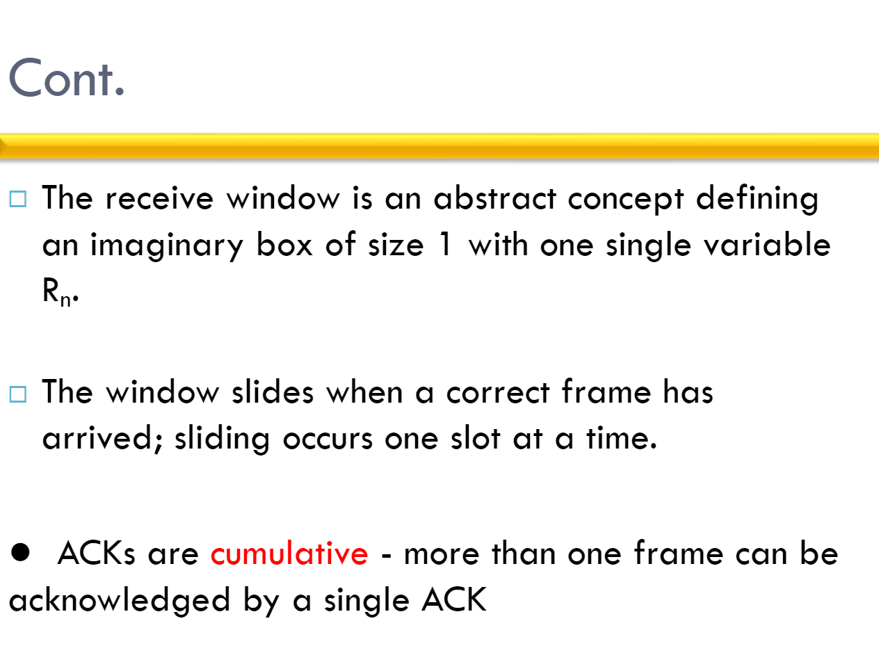

Slide 55
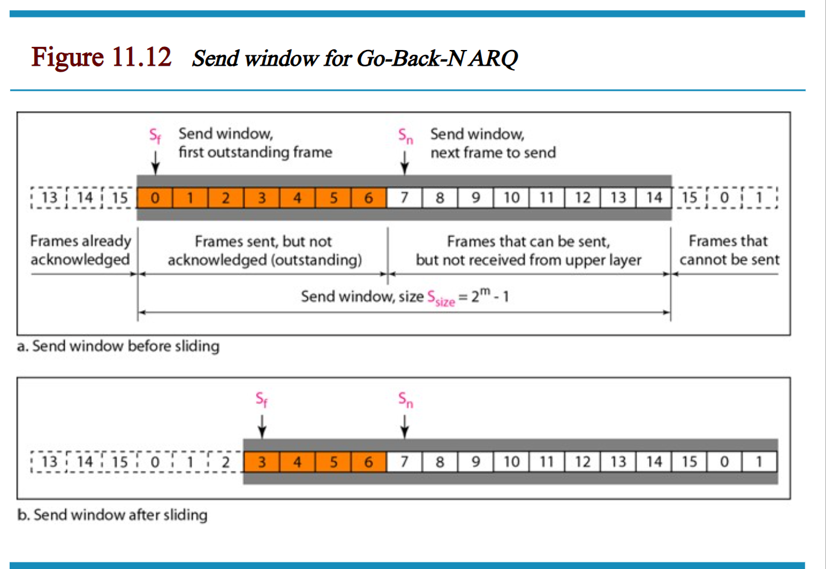

Slide 56
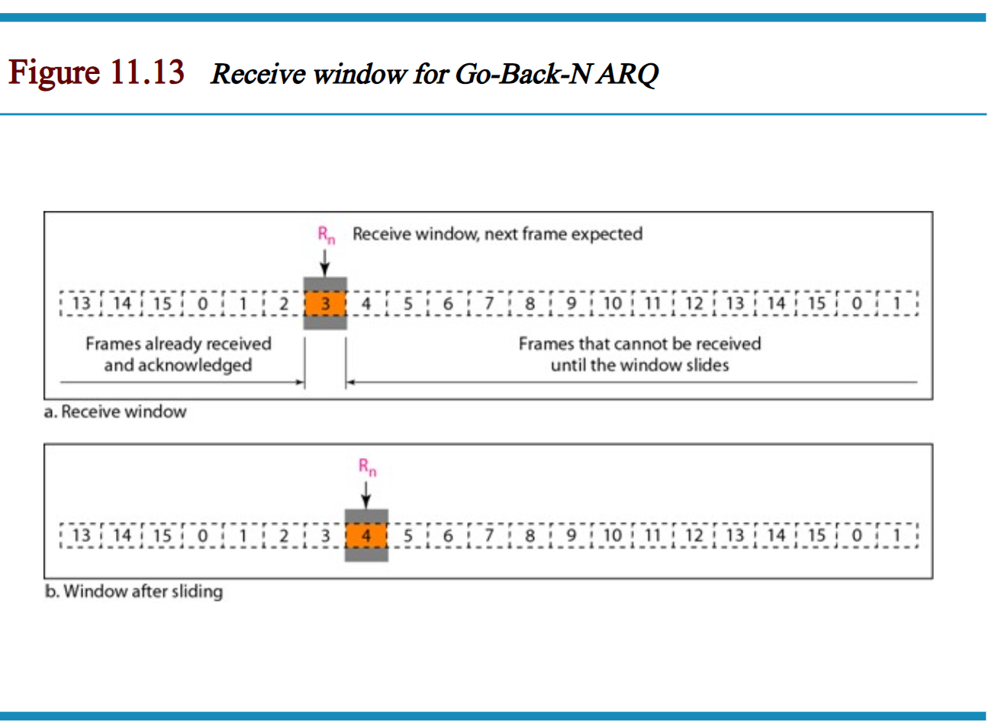

Slide 57
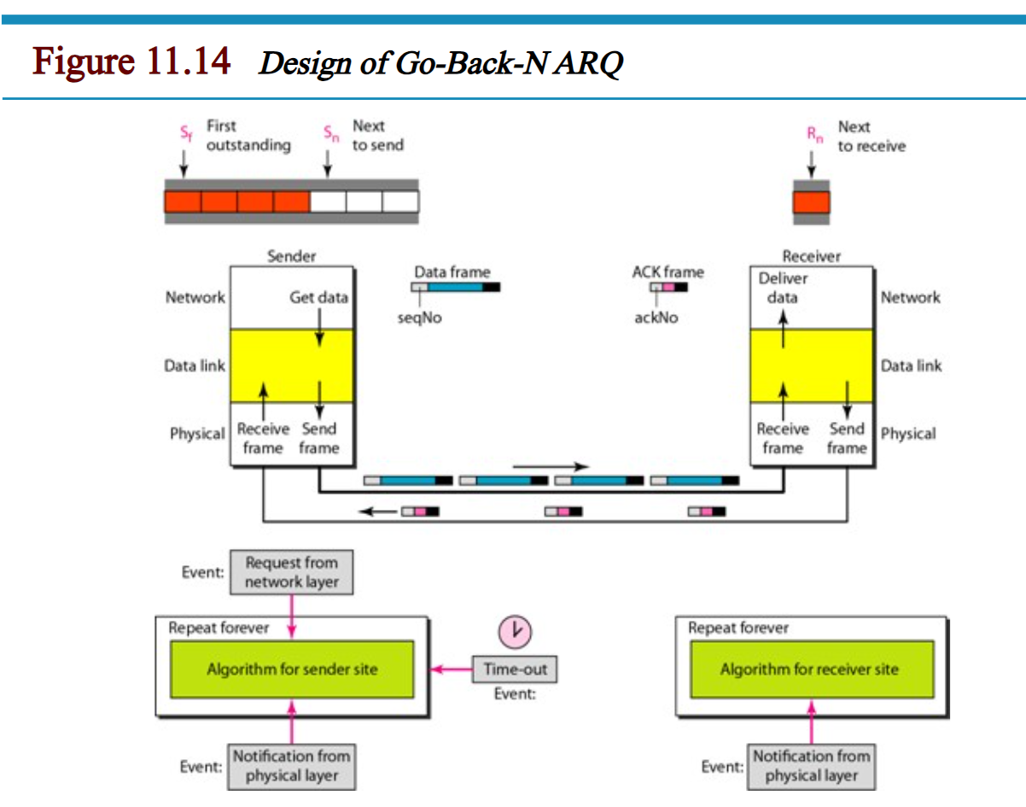

Slide 58
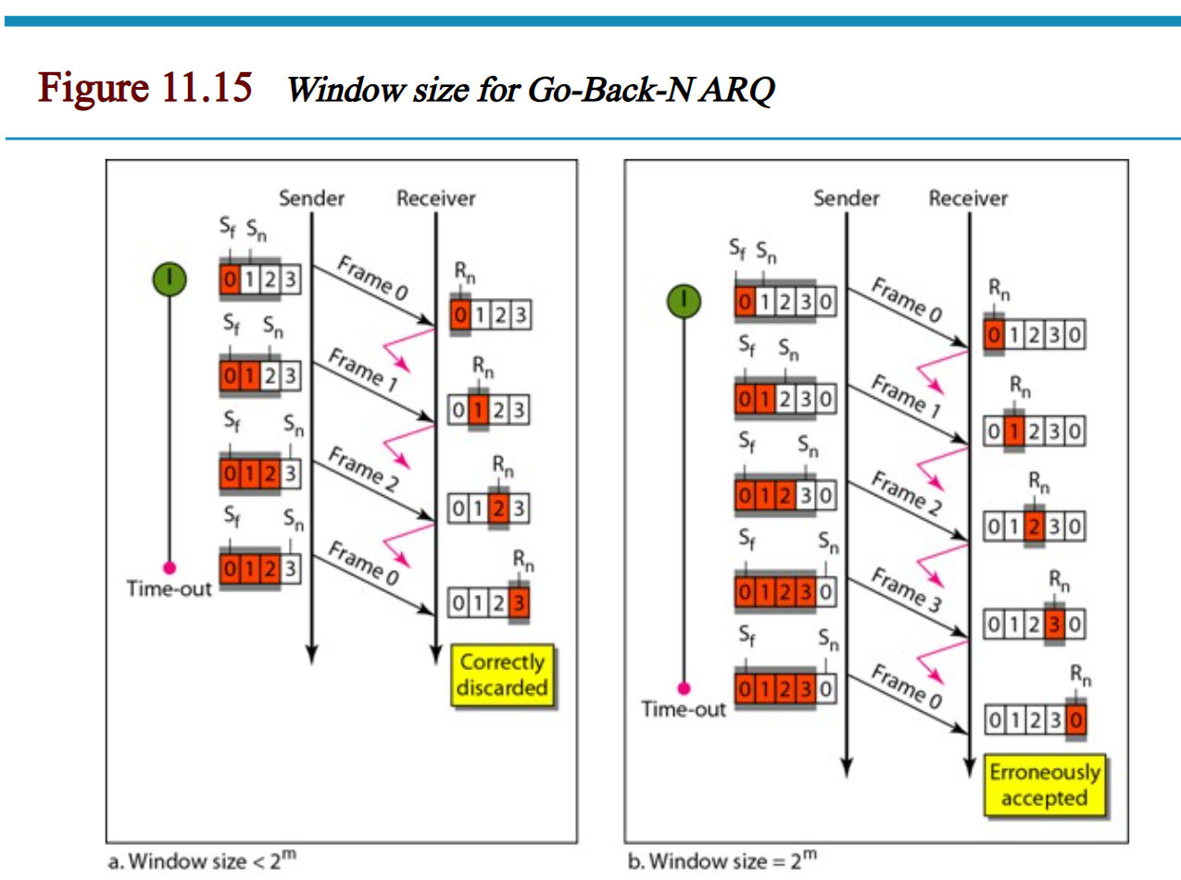

Slide 59
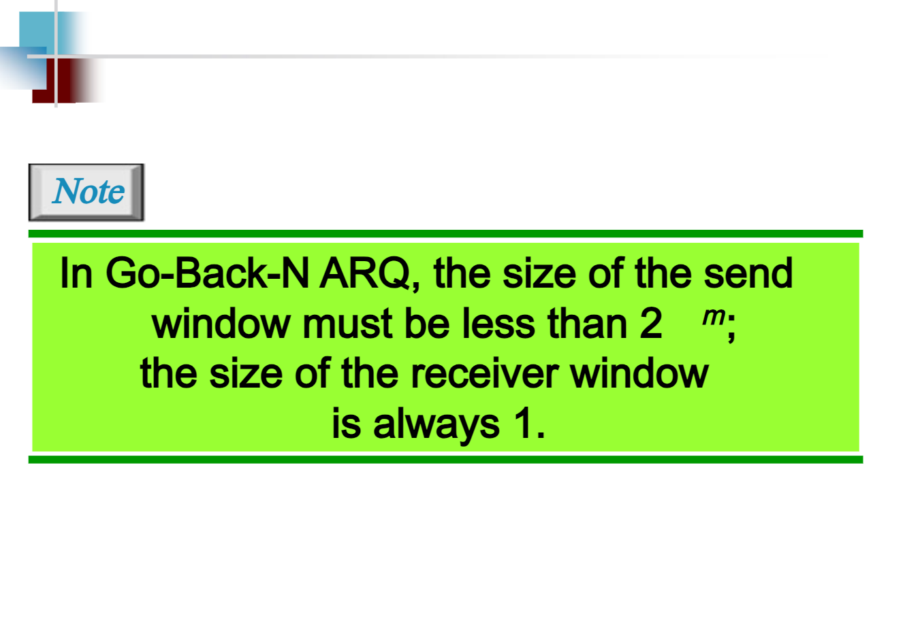

Slide 60
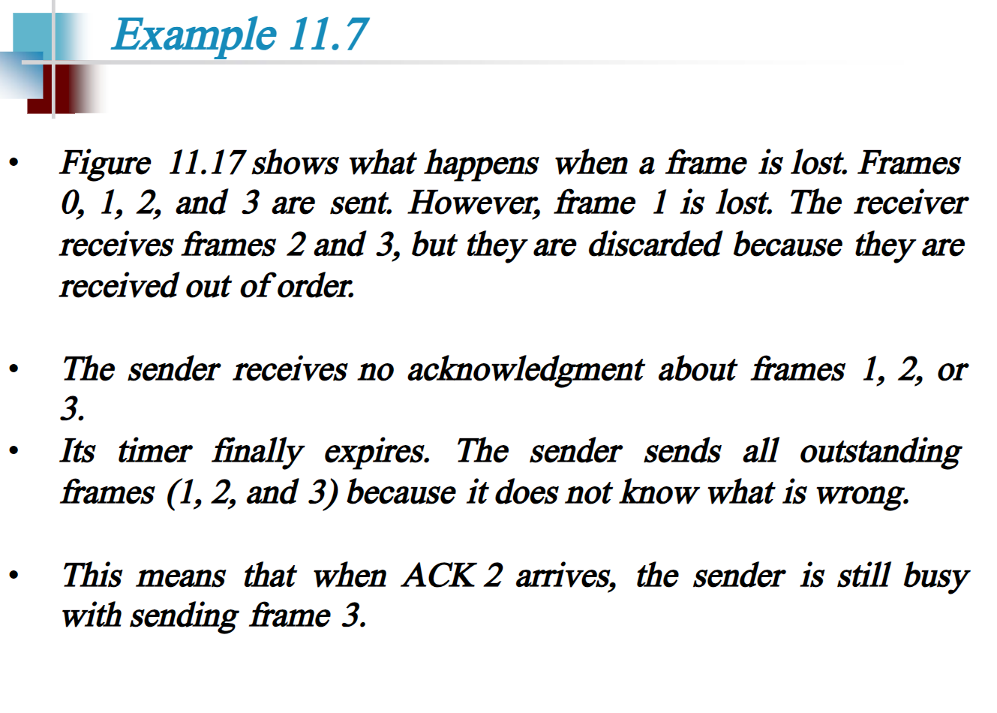

Slide 61
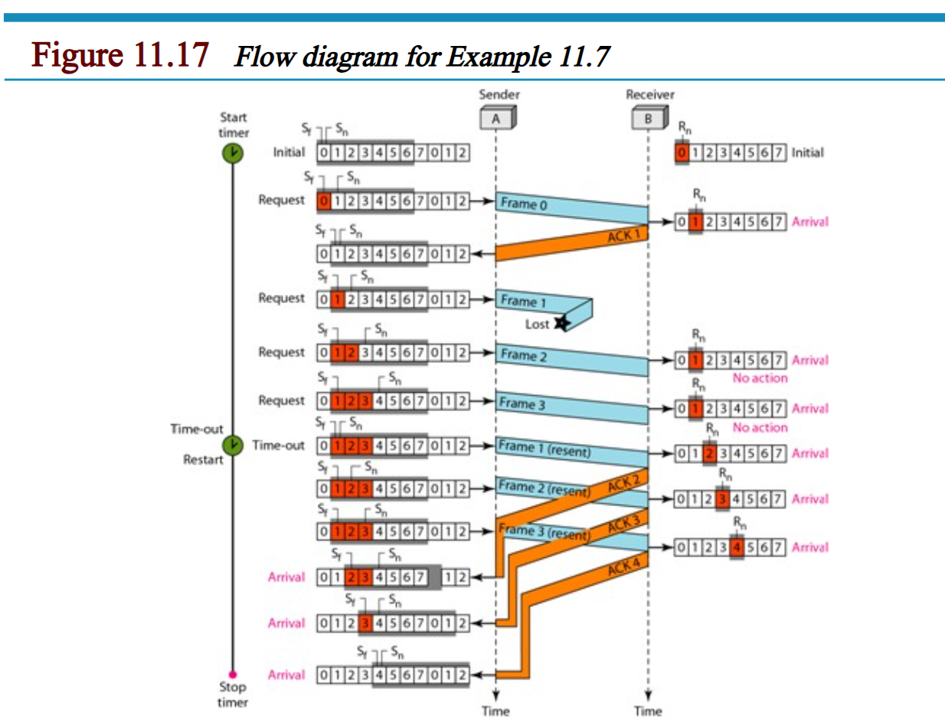

Slide 62


Slide 63


Slide 64


Slide 65


Slide 66


